Slide 1



T M A E S POLYTECHNIC(AIDED)-HOSPET
Recognized by DTE and
Approved by AICTE
Ballari Road, Hosapete – 583 201, Tel: 08394 266211,
Web Site: https://tmaespolytechichpt.com
Department Of CIVIL Engineering
Hearty Welcome to
1983
40 years of Excellence
2023
NBA EXPERT TEAM
By K LAXMI REDDY

Slide 2
Contents
Part A
1. Program at a Glance.
2. Criteria – 1 : Vision , Mission and Program Educational Objectives
3. Criteria -2 : Program Curriculum and TLP
4. Criteria –3 : Course Outcomes and Program Outcomes
5. Criteria –4: Students Performance
6. Criteria –5 : Faculty Information and Contribution.
7. Criteria –6 : Facilities and Technical Support.
8. Criteria -7 : Continuous Improvement.
Part B
OBE Philosophy of the Civil Department

Slide 3
PROGRAM AT A GLANCE
T M A E S POLYTECHNIC was established in the year 1983 and CIVILEngg. Department in the year 1983 with an intake of 30 students .
Recognized by Government of Karnataka, approved by AICTE, New Delhi and affiliated to Department of Technical Education (DTE), Bengaluru.
Academic YEAR | 1983-84 To 2003-04 | 2004-05 To 2006-07 | 2007-08 To 2009-10 | 2009-10 To 2015-16 | Till 2023-24
INTAKE | 30 | 40 | 45 | 60 | 60

Slide 4
Program at Glance
Inputs | Best Practises
DTE-Government of Karnataka Excellent Infrastructure Qualified & Dedicated Faculty 100% admissions every year | Practicing OBE and Good TLP in place Mentoring System Industry Institute Interaction Alumni Network Skill development Training programs

Slide 5
DEPARTEMENT ACHIEVEMENT
1.The program is ISO 9001 : 2015 certified.
2.100% admission for the past 20 years.
3. Full fledged teaching faculty and technical supporting staff.
4. 100 % Retention of staff.
5. 80 % of the students are placed for higher education.
6. Our Department have done third party quality.

Slide 6
FACULTY ACHIEVEMENT
1.Our teaching faculty have set Board question papers, were appointed as Chief Observer/Deputy Superintendent for various examinations conducted by BTE, Bangalore.
2. Our Ex Principal Sir Sri. Y M Umashankar sir have done Third Party Quality with an amount Approximately 1 Crore.
3. All the teaching faculty of the department are life members of ISTE.
4. All the teaching faculty of the department are members of MIE and MISTE.
5. Our staff have conducted seminars in surrounding polytechnics.

Slide 7
STUDENT ACHIEVEMENT
1.Students are members of the ISTE student chapter.
2. Topper students in Board examinations year wise.
3. students have participated in Quiz competition held in BITM Engg and got the second prize.
Sl No | YEAR | REG NO | NAME | % OF MARKS
1. | 2020-21 | 316CE20049 | SPOORT K M | 89.55
2. | 2021-22 | 316CE21009 | D KIRAN | 76.54
3. | 2022-23 | 316CE22045 | R NAYANA | 89.77

Slide 8
Criteria-1
Vision, Mission and PEOs

Slide 9
VISION OF THE T M A E S INSTITTION :
“Empowering youth by imparting quality technical education and strive to prepare students with excellent skills.”
MISSION OF THE T M A E S INSTITTION :
To offer value added quality technical education and excellent academic training to our students.
To provide state of art infrastructure with latest facilities.
To strengthen industry institute interaction.
VISION OF THE CIVIL ENGG DEPARTEMENT :
“To crate competent civil engineers with social and loral values to work successfully in the field of design, estimation and construction”.
MISSION OF THE CIVIL ENGG DEPARTEMENT :
1 : To impart quality technical education focusing on transfer of knowledge and skills development for the benefit of the profession and the society.
2 : To nature talent in students to enable them to be leaders in their chosen profession while maintaining the highest level of ethics.
3 : to promote of the spirit of enquiry, innovation, life skill and to encourage entrepreneurship.

Slide 10
PROGRAM EDUCATIONAL OBJECTIVES (PEOs)
PEO1 | To apply technical knowledge and management principles in analyzing and planning problems in field of civil engineering, while ensuring maximization of economic benefits to society and minimization of damage to ecology and environment.
PEO2 | To be life long learners with spirit of enquiry and zeal to acquire new knowledge and skills so as to remain contemporary and posses required professionals skills.
PEO3 | To Involve and flourish in professional careers through effective team-work, professional behavior and communication skills
PEO4 | To make them strongly committed to the highest level s of professional ethics and focus ensuring quality. Adherence to public policy and law ,safety, reliability and environmental sustainability in all there professional activities
PROGRAM SPECIFIC OUT COMES
PSO1:- Diploma graduates have an ability to plan, analysis, design, Execution, Lab testing for materials and to maintain cost effective structures with less usage of natural recourses.
PSO2:- The graduates of civil engineering program have the ability to take up unemployment , entrepreneurship like concerting civil engineer, contractor, Bank valuer, surveying and Cad design, research and development for sustainable civil society.
PSO3:- The graduates of civil engineering program can peruse professional growth, higher studies, leadership qualities, demonstrate professional integrity, ethics, issues related to civil engineering projects and engage life long learning.

Slide 11
Criteria-2
Program Curriculum and TLP

Slide 12
Program Curriculum & Teaching Learning Process
DTE
Curriculum
Gap Identification by a Team of Course Coordinator
Review & Approval by PAC
Actions to be taken to meet the gaps

Slide 13
Program Curriculum & Teaching Learning Process for C-20 Curriculum
Sl no | Course Component | Curriculum credits(% of contribution)
1 | Engg Sciences | 6.06
2 | Humanities & Social sciences | 3.03
3 | Basic Sciences | 9.09
4 | Audit Courses | 6.06
5 | Program Core Courses | 45.45
6 | Specialization path way | 18.18
7 | Internship/Project Courses | 12.12
Curricular mapping with POs and PSOs – Semester Wise

Slide 14
The gaps are to be identified
Major Identified Gaps in Program Curriculum Relevance to Components POs and PSOs | PO’S and PSO’s
Design/development of solution: Design solution for well-defined technical problems and assist with the design of system components or processes to meet specified needs. | PO3
Engineering practices for society: Apply appropriate technology in context of society ,sustainability, environment and ethical practices. | PO5
Project Management: Use engineering management principles individually ,as a team member or a leader to manage projects and effectively communicate about well-defined engineering activities. | PO6

Slide 15
Teaching and Learning
Initiatives and actions taken to Improve Quality of Teaching/Learning
Academic Calendar of events have prepared
Use of various instructional planning and delivery methods
Shown lecturing classes through tutorials and Remedial classes.
Demonstrations in the class room
A group of students are allocated to each Faculty who act as mentor to address the grievances of each student and after counseling, suitable suggestions/ advise is given and the Department will try to resolve the issues of mentee.
Encouraged to participate in various competitive exams/quest/quiz. Inspired to take up competitive examinations like DCET etc.,
Remedial/Tutorial Classes. Along with some Seminars or Guest lectures have been arranged.

Slide 16
Criteria-3
Course outcomes & Program Outcomes

Slide 17
Program Specific Outcomes [PSOs]
Program Outcomes [POs]
PO1- Basic and Discipline Specific Knowledge: Apply knowledge of basic mathematics, science and engineering fundamentals and engineering specialization to solve the engineering problems.
PO2 -Problem Analysis: Identify and analyze well defined engineering problems using codified standard methods.
PO3- Design/Development of Solutions: Design solutions for well-defined technical problems and assist with the design of systems components or processes to meet specified needs.
PO4 -Engineering Tools, Experimentation and Testing: Apply modern engineering tools and appropriate technique to conduct standard tests and measurements.
PO5 -Engineering practices for society, sustainability and environment: Apply appropriate technology in context of society, sustainability, environment and ethical practices.
PO6 -Project Management: Use engineering management principles individually, as a team member or a leader to manage projects and effectively communicate about well-defined engineering activities.
PO7- Life-Long Learning: Ability to analyze individual needs and engage in updating in the context of technological changes.
PSO1 | Diploma graduates have an ability to plan, analysis, design, execution, lab testing for materials and to maintain cost effective structures with less usage of natural resources
PSO2 | The graduates of civil engineering programme have the ability to take up unemployment, entrepreneurship like consulting civil engineer, contractor, bank valuer, surveying and cadd design, research and development for sustainable civil society.
PSO3 | The e The Graduates of civil engineering programme can peruse professional growth, higher studies, leadership qualities, demonstrate professional integrity, ethics, issues related to civil engineering projects and engage in lifelong learning.

Slide 18
Sample Course Outcomes & Mapping with POs & PSOs
Course Name: Construction of Materials
COs | Statement
C101.1 | Identify relevant natural construction materials.
C101.2 | Select relevant artificial construction materials
C101.3 | Identify and use of processed construction materials.
C101.4 | Select relevant special type of construction materials
 | PO-1 | PO-2 | PO-3 | PO-4 | PO-5 | PO-6 | PO-7 | PSO-1 | PSO-2 | PSO-3
C201.1 | 3 | - | - | 3 | - | - | 3 |  | - | 3
C201.2 | 3 | - | - | 3 | - | - | 3 |  | - | 3
C201.3 | 3 | - | - | 3 | - | - | 3 |  | - | 3
C201.4 | 3 | - | - | 3 | - | - | 3 |  | - | 3
Average | 3 | - | - | 3 | - | - | 3 |  | - | 3
Level 3 represents for HIGH, Level 2 represents for MODERATE, Level 1 represents for LOW

Slide 19
Curriculum for attaining POs and PSOs.
Sl. no | SEM | Course | Course Code | PO1 | PO2 | PO3 | PO4 | PO5 | PO6 | PO7 | PSO1 | PSO2 | PSO3
1 | 1 | MOC | 20CE11T | 3 |  |  | 3 |  |  | 3 | 3 | 3 | 3
 |  | CUM SKILLS | 20EG01P |  |  |  |  |  | 3 | 3 |  |  | 3
2
 |  | ST ANALYSIS | 20SC02P | 3 | 3 |  | 3 | 3 |  | 3 | 3 |  | 3
3
 |  | IT SKILLS | 20CS01P | 3 |  |  | 3 |  |  | 3 | 3 |  | 3
4
5 | 2 | ENGG MATHS | 20SC01T | 3 |  | 3 |  |  |  | 3 | 3 |  | 3
 |  | PMS | 20PM01T | 3 | 3 | 3 | 1 | 3 | 1 | 3 | 3 | 3 | 3
6
7 |  | CEG | 20CE21P | 3 | 3 |  | 3 |  |  |  | 3 | 2 | 3
8 |  | BASIC SURV | 20CE22P | 3 | 3 | 3 | 3 |  |  | 1 | 3 | 3 | 3
9 |  | FEEE | 20EE01P | 3 |  |  | 3 |  |  |  | 2 |  | 3
10 | 3 | ENG MECH SOM | 20CE31P | 3 | 3 | 3 |  |  |  |  | 3 | 3 | 3
11 |  | MODETN SURV | 20CE32P | 3 | 3 |  | 3 |  |  | 3 | 3 | 3 | 3
12 |  | CONSTR TECHN | 20CE33P | 3 | 3 | 3 | 3 | 3 |  | 3 | 3 | 1 | 3
13 |  | BULD DRW CADD | 20CE34P | 3 |  |  | 3 | 1 |  | 3 | 3 | 3 | 3
14 | 4 | CONCRT TECHN | 20CE41P | 3 |  |  | 3 | 2 |  |  | 2 |  | 3
15 |  | BULD EST & VAL | 20CE42P | 3 | 3 |  | 3 |  |  | 3 |  | 3 | 3
16 |  | SITE MANAGEMENT | 20CE43P | 3 | 3 | 3 | 1 | 1 | 1 | 3 | 3 | 3 | 3
17 |  | DISG & DET OF RCC | 20CE44P | 1 | 3 | 3 | 1 |  |  |  | 3 | 3 | 3
18 | 5 | BUILT ENVIRONMENT | 20CE54I | 3 | 3 | 3 | 3 | 3 |  | 3 | 3 | 3 | 3
19 | 6 | INPLANT TR/PROJECT | 20CE61S | 3 | 3 | 3 | 3 | 3 | 3 | 3 | 3 | 3 | 3
Avge of CO’s with PO’s and PSO’s |  |  |  | 2.889 | 3 | 3 | 2.625 | 1.9 | 1.6 | 2.5 | 2.722 | 2.571 | 2.714

Slide 20
Attainment of POs

Slide 21
Attainment of POs through Direct Assessment tools
For 20 series batch

Slide 22
Attainment of POs through Indirect Assessment tools
For 20 series batch

Slide 23
Overall Attainment of POs (2020-23)
PO/PSOs | PO1 | PO2 | PO3 | PO4 | PO5 | PO6 | PO7 | PSO1 | PSO2 | PSO3
Target | 2.889 | 3 | 3 | 2.625 | 1.9 | 1.6 | 2.5 | 2.722 | 2.571 | 2.714
Achieved | 2.329 | 2.518 | 2.508 | 2.197 | 2.064 | 2.228 | 2.321 | 2.329 | 2.518 | 2.508

Slide 24
Criteria-4
Students Performance

Slide 25
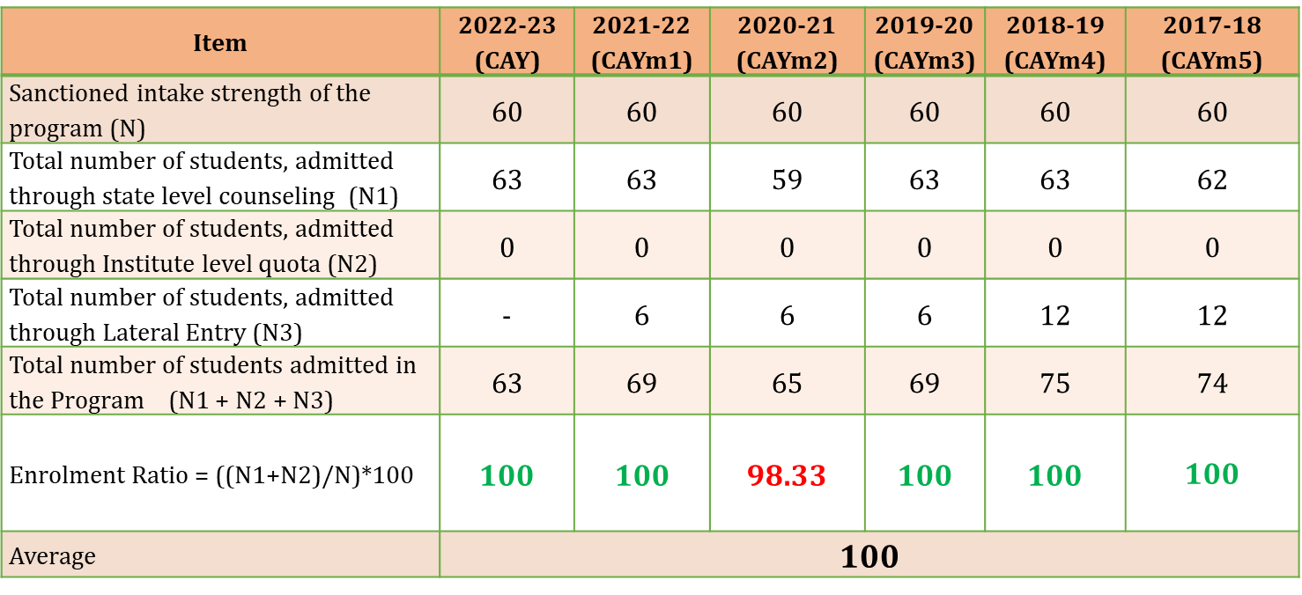
Details of sanctioned intake and total no. of students admitted
Item | 2023-24 (CAY) | 2022-23 (CAYm1) | 2021-22 (CAYm2) | 2020-21 (CAYm3) | 2019-20 (CAYm4) | 2018-19 (CAYm5)
Sanctioned intake strength of the program (N) | 60 | 60 | 60 | 60 | 60 | 60
Total number of students, admitted through state level counseling (N1) | 60 | 59 | 46 | 63 | 58 | 59
Total number of students, admitted through Institute level quota (N2) | 0 | 0 | 0 | 0 | 0 | 0
Total number of students, admitted through Lateral Entry (N3) | 02 | 0 | 01 | 01 | 0 | 02
Total number of students admitted in the Program (N1 + N2 + N3) | 62 | 59 | 47 | 64 | 58 | 61
Enrolment Ratio = ((N1+N2)/N)*100 | 103 | 98.33 | 78.33 | 100 | 96.66
Average | 100

Slide 26
Success Rate without Backlogs
Item | Last Year Graduate, (LYG) 2020-21 | Last Year Graduate minus 1 Batch, (LYGm1) 2019-20 | Last Year Graduate minus 2 Batch, (LYGm2) 2018-19
Total number of students (X) (admitted through state level counseling +admitted through Institute on level quota + Actually admitted through lateral entry) (N1 + N2 + N3) | 64 | 58 | 61
Number of students who have graduated without backlogs in the stipulated period (Y) | 17 | 11 | 07
Success Index [ SI = Y / X ] | 0.265 | 0.189 | 0.114
Average SI | 0.189
Success rate | 7.57

Slide 27
Success Rate with Backlogs
Item | Last Year Graduate, (LYG) 2019-20 | Last Year Graduate minus 1 Batch, (LYGm1) 2018-19 | Last Year Graduate minus 2 Batch, (LYGm2) 2017-18
Total number of students (X) (admitted through state level counseling +admitted through Institute on level quota + Actually admitted through lateral entry) (N1 + N2 + N3) | 64 | 58 | 61
Number of students who have graduated with backlog in the stipulated period (Y) | 35 | 20 | 21
Success Index [ SI = Y / X ] | 0.546 | 0.344 | 0.344
Average SI | 0.411
Success rate | 16.45

Slide 28
Academic Performance in First Year
Academic Performance | 2022-23 (CAYm1) | 2021-22 (CAYm2) | 2020-21 (CAYm3)
Mean of CGPA or Mean Percentage of all successful students (X) | 7.904 | 8.358 | 7.748
Total no. of successful students (Y) | 09 | 10 | 37
Total no. of students appeared in the examination (Z) | 46 | 37 | 59
API = X*(Y/Z) | 1.546 | 2.258 | 4.858
Average API = (AP1 + AP2 + AP3)/3 | 2.887
Academic Performance Level | 7.217

Slide 29
Academic Performance in Second Year
Academic Performance | 2021-22 (CAYm2) | 2020-21 (CAYm3) | 2019-20 (CAYm4)
Mean of CGPA or Mean Percentage of all successful students (X) | 8.099 | 8.032 | 7.578
Total no. of successful students (Y) | 15 | 35 | 19
Total no. of students appeared in the examination (Z) | 24 | 50 | 38
API = X*(Y/Z) | 5.061 | 5.622 | 3.789
Average API = (AP1 + AP2 + AP3)/3 | 4.824
Academic Performance Level | 12.06

Slide 30
Academic Performance in Final Year
Academic Performance | 2020-21 (LYG) | 2019-20 (LYGm1) | 2018-19 (LYGm2)
Mean of CGPA or Mean Percentage of all successful students (X) | 8.196 | 8.184 | 7.333
Total no. of successful students (Y) | 35 | 20 | 21
Total no. of students appeared in the examination (Z) | 48 | 34 | 37
API = X*(Y/Z) | 5.976 | 4.814 | 4.389
Average API = (AP1 + AP2 + AP3)/3 | 5.059
Academic Performance Level | 12.649

Slide 31
Placement, Higher Studies and Entrepreneurship
Item | 2020-21 (LYG) | 2019-20 (LYGm1) | 2018-19 ( LYGm2)
Total No. of Final Year Students (N) | 35 | 20 | 21
No. of students placed (X) | 03 | 02 | 02
No. of students admitted to higher studies (Y) | 23 | 12 | 15
No. of students as entrepreneur (Z) | 0 | 0 | 0
Placement Index (P) : (1.25X + Y +Z)/N | 0.743 | 0.690 | 0.833
Average placement= (P1 + P2 + P3)/3 | 0.755
Assessment Points | 30.213
Placement Index
Higher studies Index
Placemnt, Higher Studies
Slno. | Programme | 2020-21 | 2019-20 | 2018-19
 |  | Students Placed & Higher Studies* | Students Placed & Higher Studies* | Students Placed & Higher Studies*
1 | Civil Engineering | 26 | 14 | 17

Slide 32
Professional Events
Sl No | Name of the Staff | Designation | Departement | MISTE NUMBER
1. | K LAXMI REDDY | Selection grade lecturer | CIVIL | LM45582
2. | PRAKASHAIHA N S | Selection grade lecturer | CIVIL | LM132829
3. | H SHANKAR BABU | Lecturer | CIVIL | LM132828
4. | ADIVEPPA AMATENNAVAR | Lecturer | CIVIL | LM132826
5. | GIRISH KUMAR B | Lecturer | CIVIL | LM132827

Slide 33
Criteria 5
Faculty Information and Contribution

Slide 34
Staff List Academic year 2023-24
Sl no | Name | Qualification | Designation
1 | Sri Laxmi Reddy K | HOD | BE
2 | Sri Prakashiah NS | Sl.Gr.LECT | BE
3 | Sri Shankar Babu | LECT | BE
4 | Sri Adiveppa AM | LECT | BE MTech
5 | Sri Girish Kumar B | LECT | BE
6 | Sri MallewshwaraGowda | LECT | BE
7 | Sri Shivaraj BH | LECT | MA Phd
8 | Sri Anand T | LECT | Msc
9 | Sri K Manjana Gowda | Sl.Gr.LECT | BE
10 | Smt Yamuna K | LECT | M.A. Med
11 | Smt Aralihalli Spoorthy | LECT | BE
12 | Smt Rekha | LECT | BE

Slide 35
Student Faculty Ratio
Year | N | F | SFR=N/F
CAY 2023-24 | 192 | 8.33 | 192/8.33=23.04
CAYm1 2022-23 | 192 | 9.16 | 192/9.16=20.96
CAYm2 2021-22 | 192 | 8.49 | 192/8.49=22.61
Avg SFR |  |  | 22.20
SFR

Slide 36
Faculty Qualification
Years | X | Y | F | FQ=2.0*(10x+7y)/F
2023-24 | 02 | 10 | 8 | 22.50
2022-23 | 03 | 10 | 8 | 25.00
2021-22 | 02 | 11 | 8 | 24.25
Average Assessment |  |  |  | 23.91
FACULTY QUALIFICATION

Slide 37
Faculty Retention
Description | CAY(2023-24) | CAY-M1(2022-23) | CAY- M2(2020-21)
No.of. Faculty Retained | 12 | 13 | 13
Total No.of. Faculty | 12 | 13 | 13
% Of. Faculty Retained | 100% | 100% | 100%
Retention

Slide 38
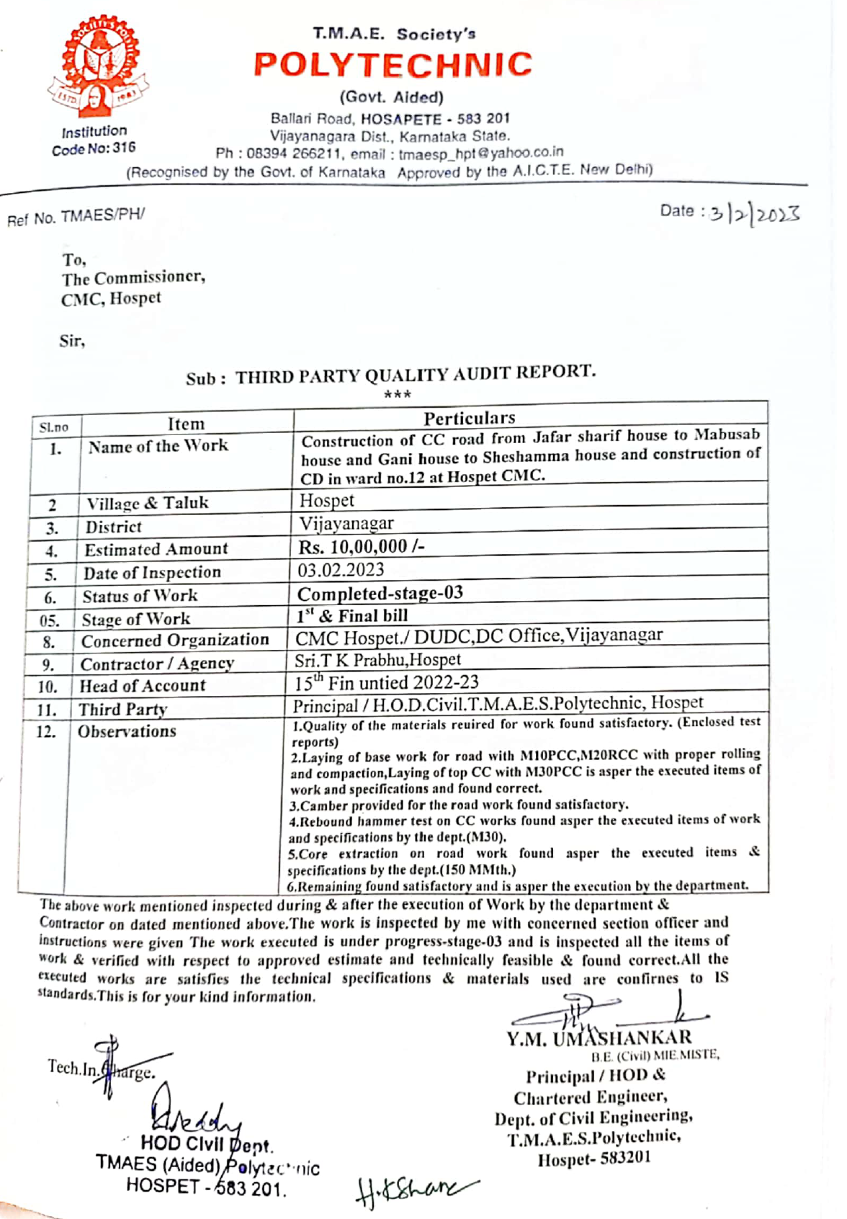
THIRD PARTY QUALITY AUDIT REPORT

Slide 39
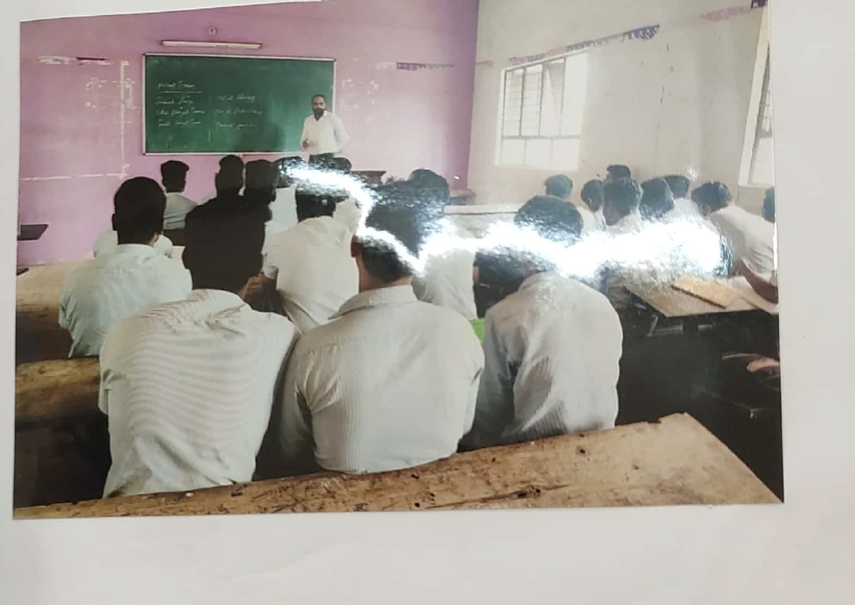
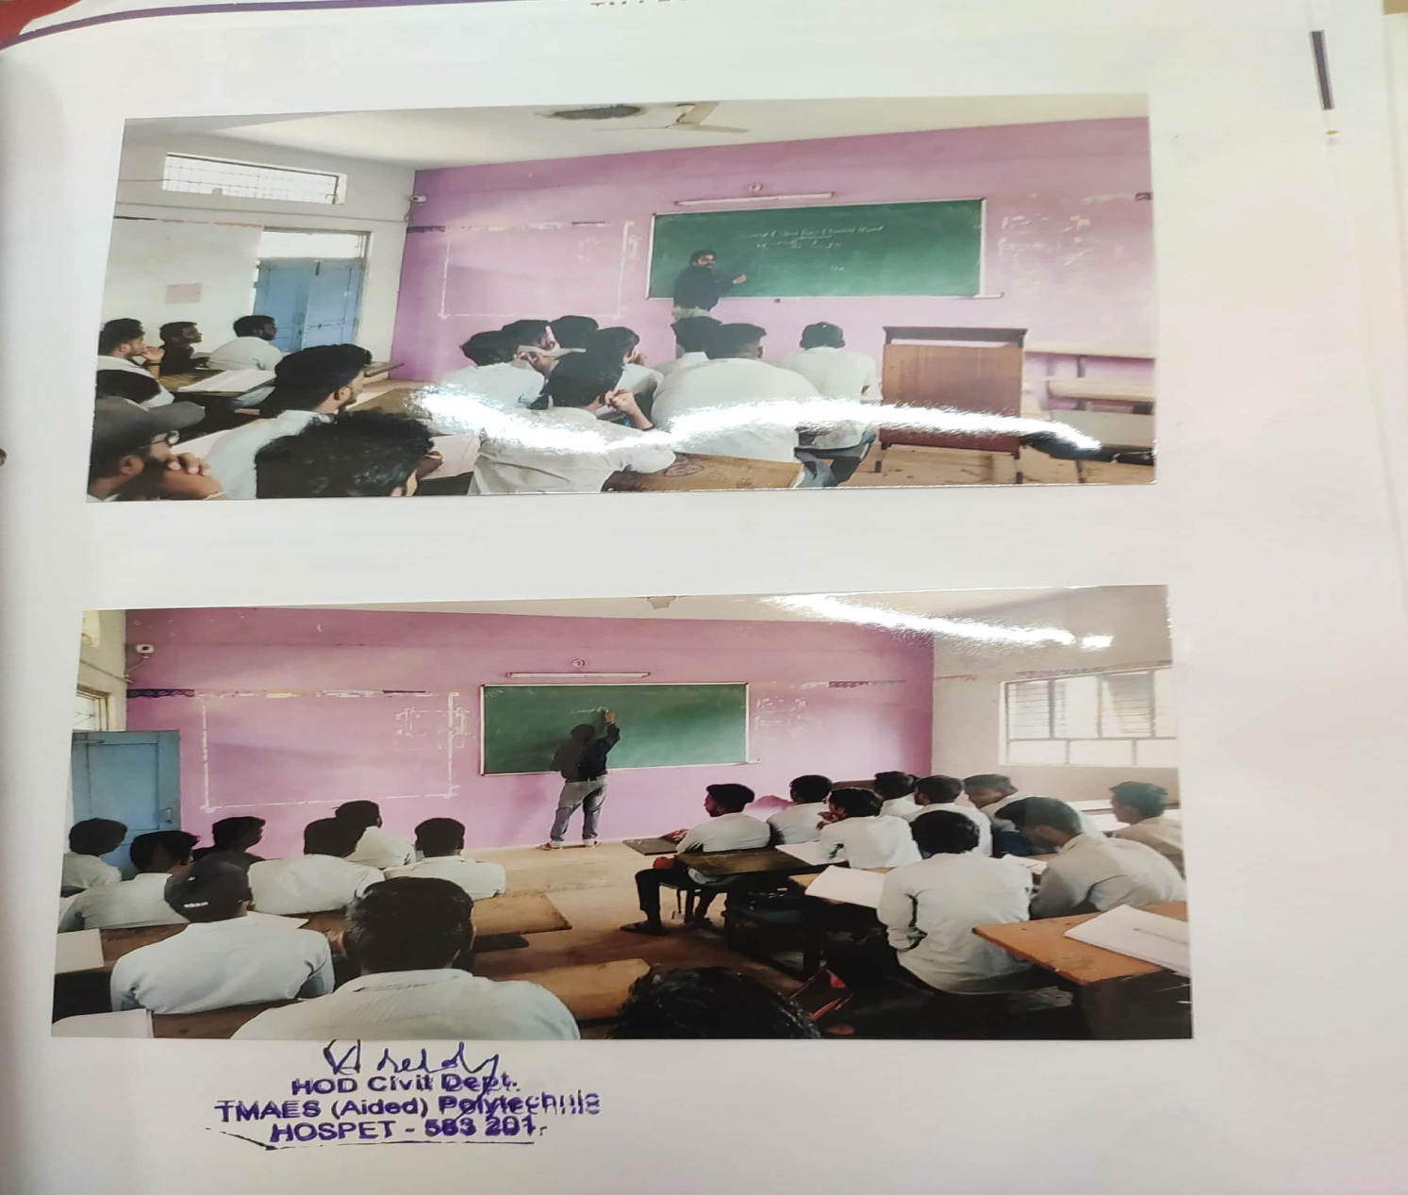
FACULTY ATTENDING WORKSHOPS IN OTHER POLYTECHNICS :

Slide 40
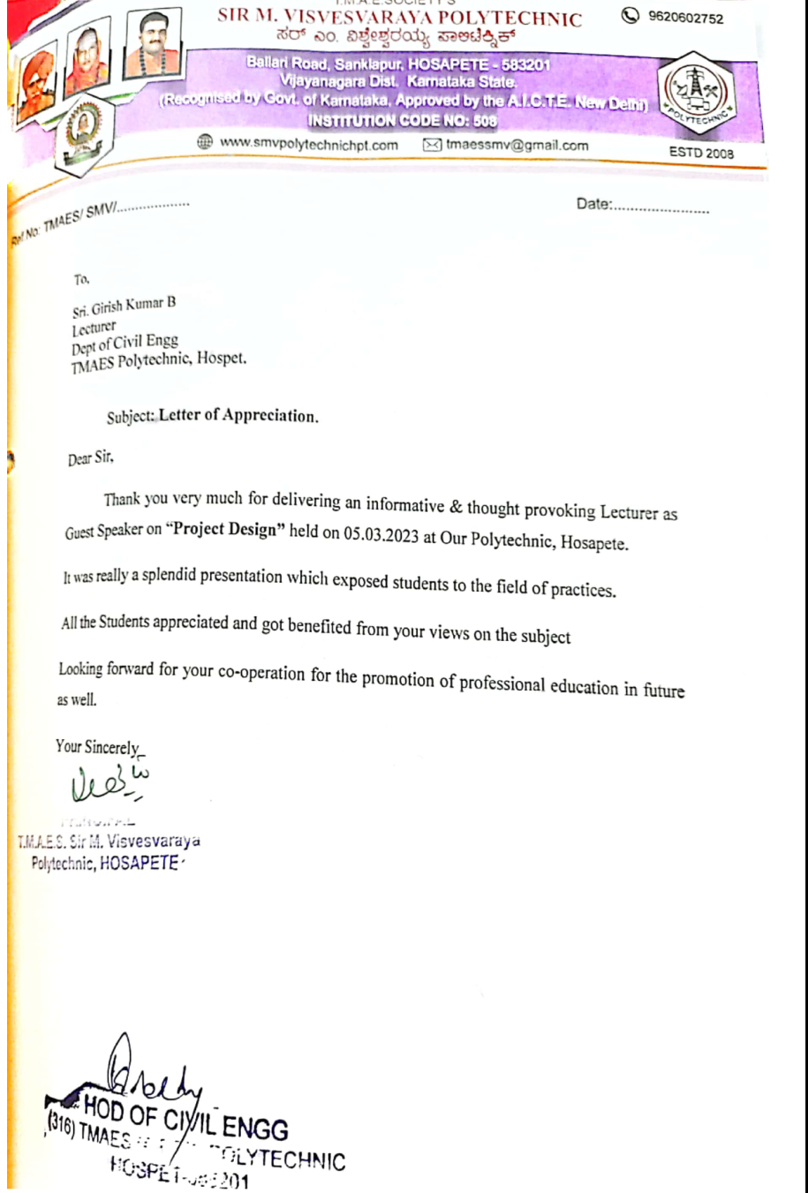

FACULTY APPRAISAL FORM

Slide 41
Criteria 6
FACILITIES AND TECHNICAL SUPPORT

Slide 42
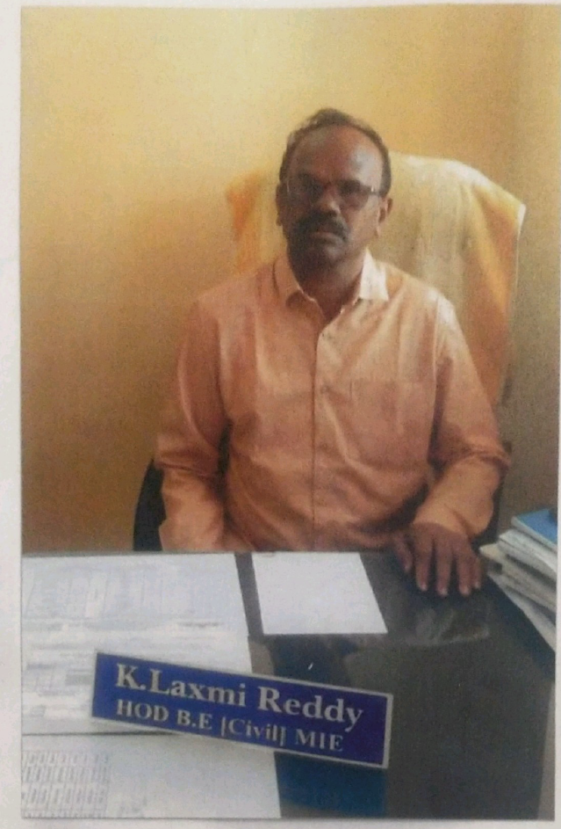
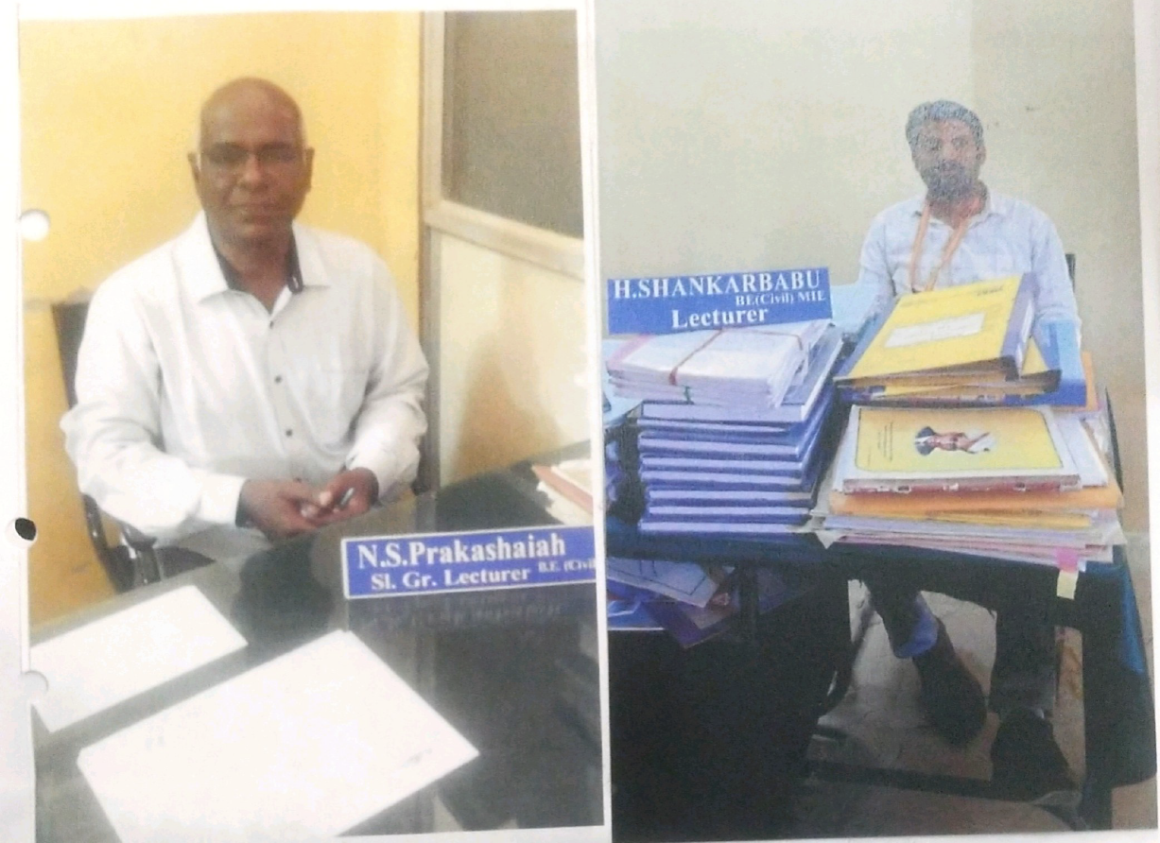
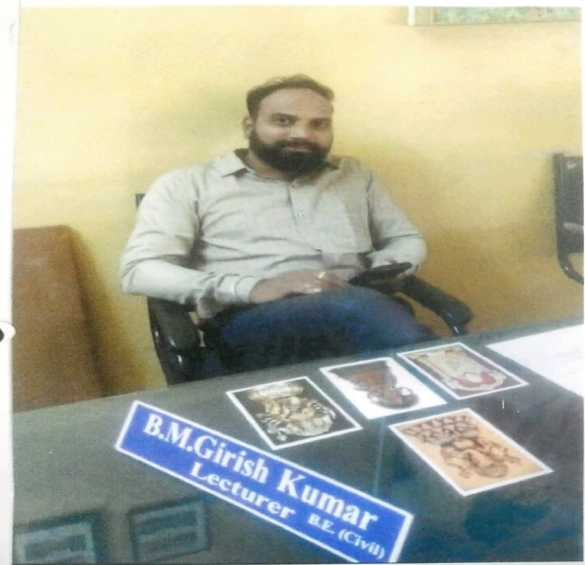
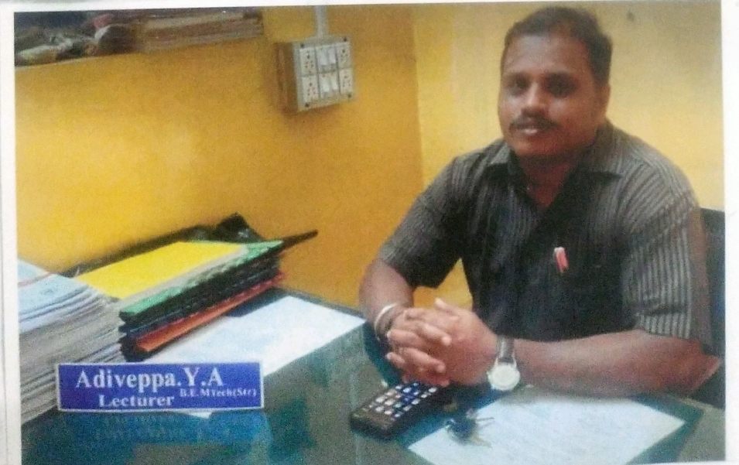
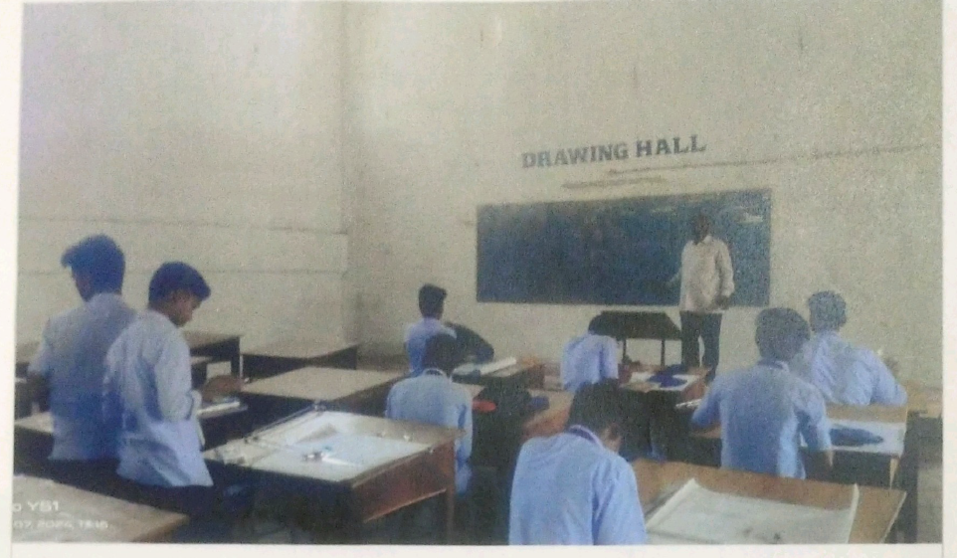
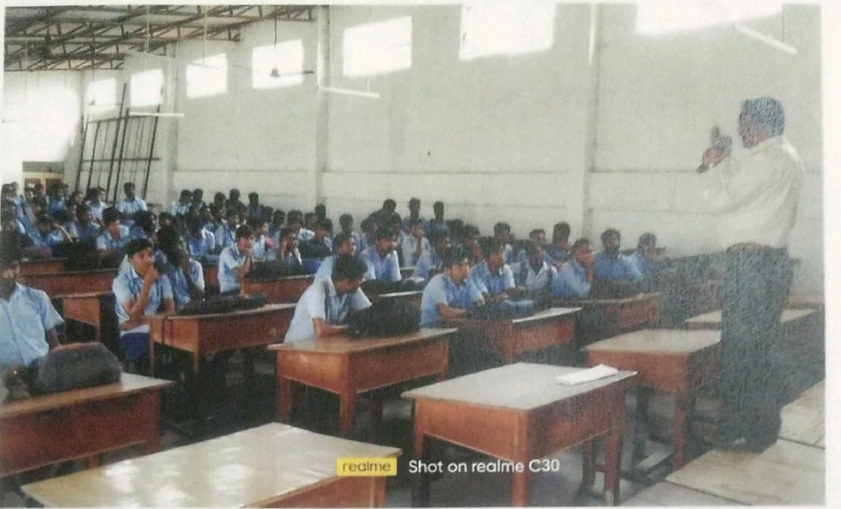
Availability of adequate HOD Room faculty rooms and class rooms.
Sl No | Name of the Room | Carpet are in sq m
1. | LH-5 | 68
2. | LH-9 | 68
3. | LH-21 | 68
4. | HOD CABIN | 09
5. 6. | FACULTY ROOM DRAWING HALL | 25 105

Slide 43
Availability of adequate, well-equipped classrooms
Sl No | Name of the Laboratory | Carpet area in sq mt | Name of the Equipments | Specifications of Each Equipment
1. | IT Skills lab | 41 | PC 20, Printer,USB Batteries | I3 Processor,3.0GHz,2 GB RAM with 64-bit, Windows 7 with 2009 version.
2 | SA Lab | 41 | PC 20, Printer,USB Batteries | I3 Processor,3.0GHz,2 GB RAM with 64-bit, Windows 7 with 2009 version.
3. | Engg Mech & SOM | 41 | PC 20, Printer,USB Batteries, Rockwell hardness machine, charpy test machine, TM machine. | I3 Processor,3.0GHz,2 GB RAM with 64-bit, Windows 7 with 2009 version.Utm Machine with 20 ton,Rockwel machine with 150kgf,60kgf capacity
4. | Modern surveying & Basic surveying | 68 | Total station, Auto level, theodolite and Dumpy level. | South , NTS-362L.20 seconds theodolite.
5. | Construction Techniques | 68 | Pyconometers,Core cutter, cube moulds. Weighing machine. | Temperature stable between 15 -35 ° with humidity 20-80% for pyconometer. Core cutter made of steel 127.3mm long and 100mm internal dia, steel doll 25mm high .Weighing machine with 10kg & 3kg capacity.

Slide 44
Availability of adequate, well-equipped classrooms
Sl No | Name of the Laboratory | Carpet area in sq mt | Name of the Equipments | Specifications of Each Equipment
6. | Building Drawing using CADD | 68 | PC 20, Printer,USB Batteries, CADD software 2014 version | I3 Processor,3.0GHz,2 GB RAM with 64-bit, Windows 7 with 2009 version.
7. | Concrete Technology | 68 | Pyconometer, Impact testing Machine, Compression testing machine, V cat apparatus etc. | Temperature stable between 15 -35 ° with humidity 20-80% for pyconometr. V cat consists of frame bearing a movable flexure of 300gm weights with 10mm dia. Compression testing machine with1000kN
8. | Site Management | 41 | PC 20, Printer,USB Batteries, M S Project 2010 | I3 Processor,3.0GHz,2 GB RAM with 64-bit, Windows 7 with 2009 version M S Project 2010 version.
9. | Design and Detailing of RCC | 41,68 | PC 20, Printer,USB Batteries, Bar bending table. | IS 456-2000 and SP-16 for design and detailing of RCC.

Slide 45
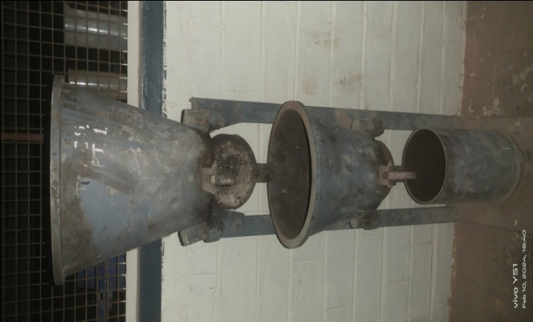
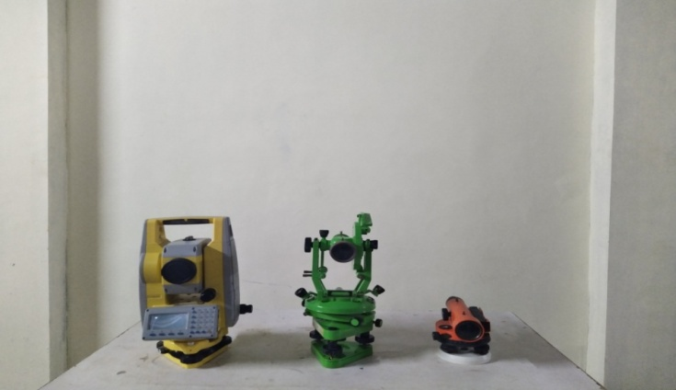
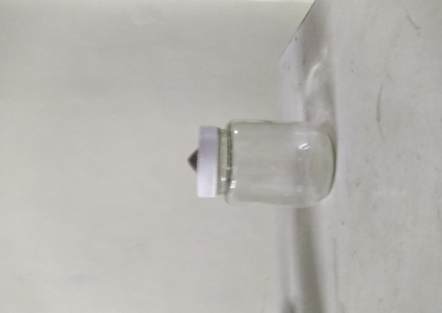
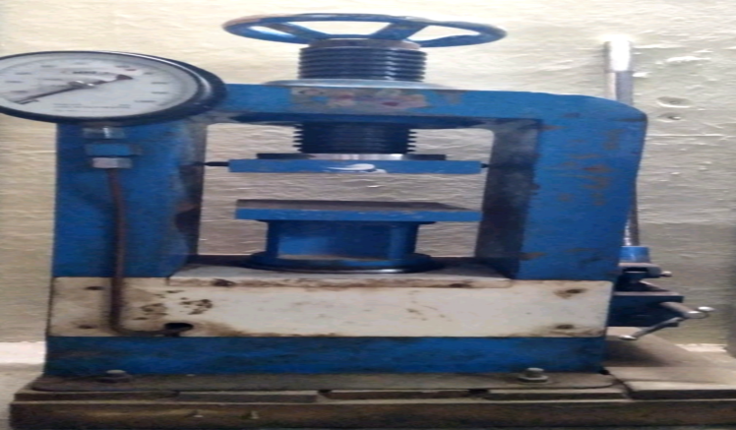
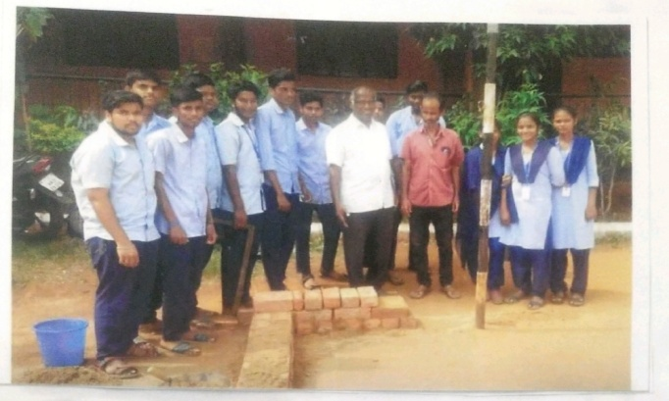
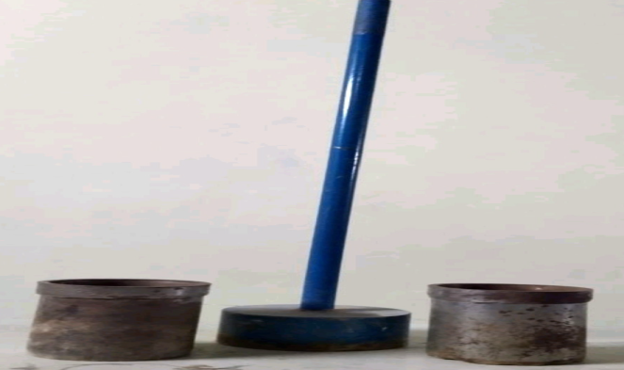
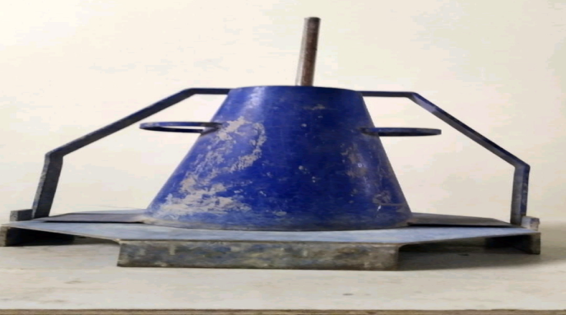
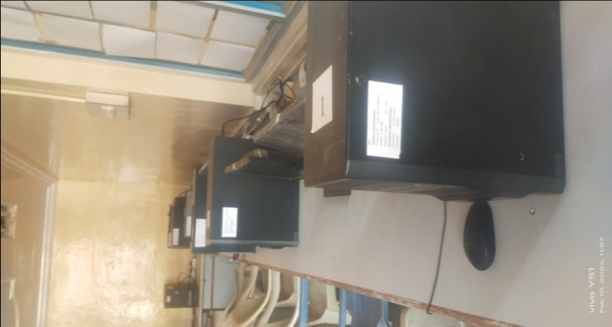
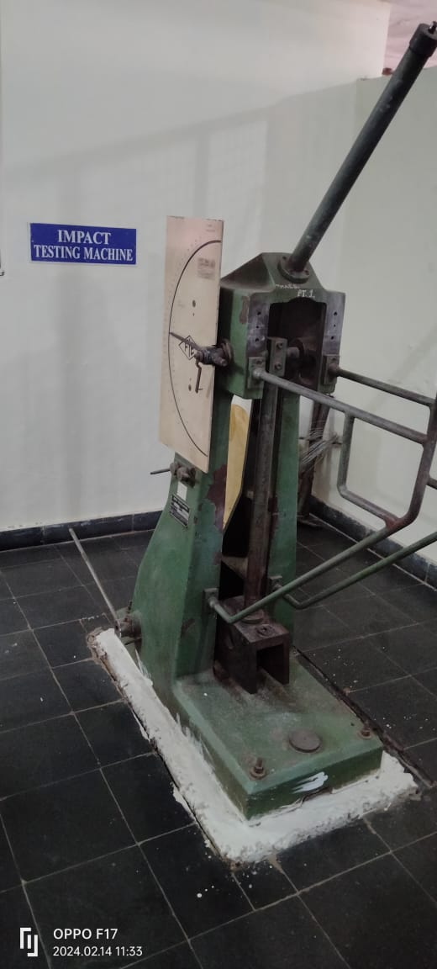
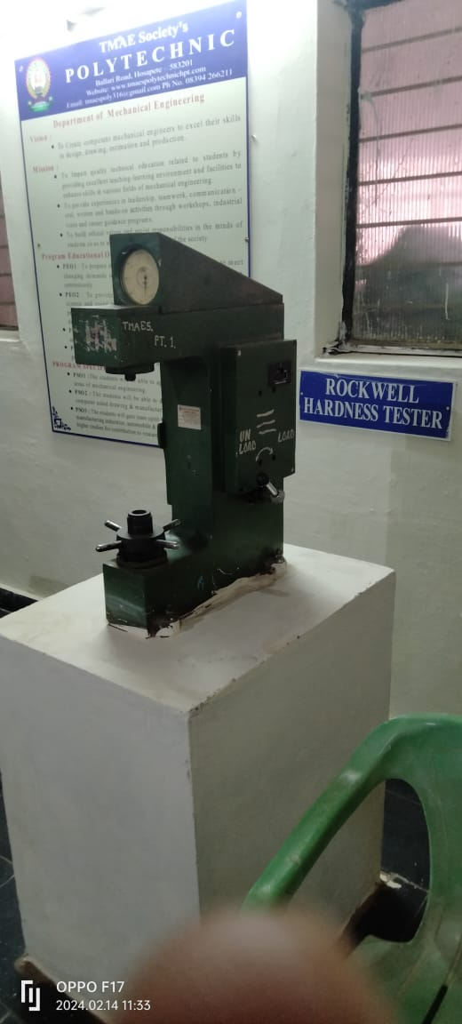
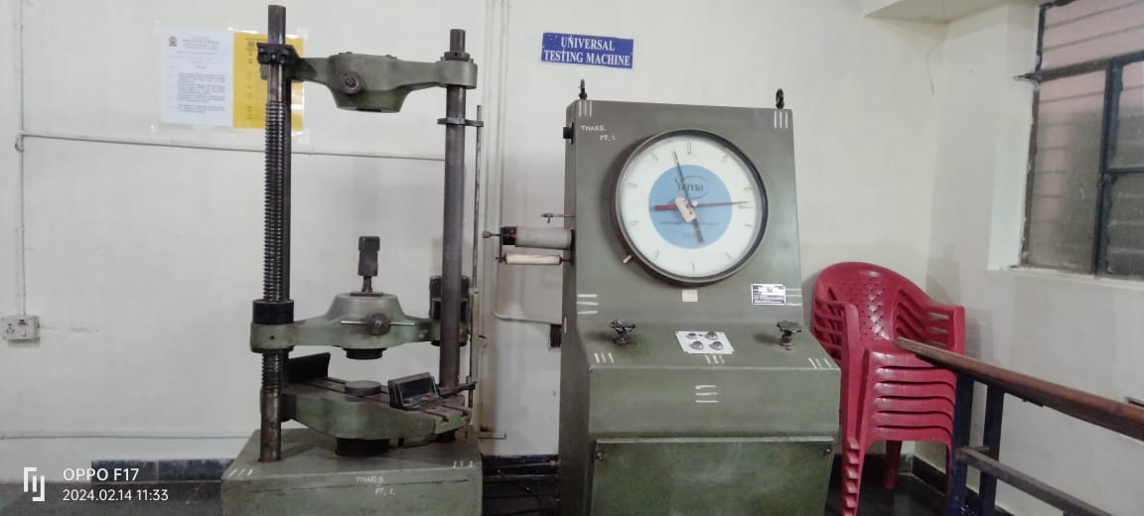
COMPRESSIVE TESTING MACHINE
COMPACTION FACTOR
EQUIPMENTS USED IN LABORATORIES
TOTAL STATION,THEODOLITE
PCONOMETER
C ON TECHNOLOGY LAB
SLUMP CONE
COMPUTER LAB
CORE CUTTER
CHARPY TESTING MACHINE
UTM MACHINE
ROCKWEL HARDNESS MACHINE

Slide 46
Criteria 7
CONTINUOUS IMPROVEMENT

Slide 47
Gap Analysis and Action taken
Identified gap | description | Action Taken
PO3 | Design /Development of solution | 1.A lecture on Concept of Shear force and Bending moment. 2.Design of two way slab. 3. Earth quake resistance building and PSC structures. 4. Theory of Simple bending. 5. Concept of centroid of unequal sections
PO5 | Engineering practices for society | A lecture Types of roads and alternative materials. 2. Stabilized cement and soil block and precast products. Water proofing and treatment for slbs.
PO6 | Project management | A presentation on Time management. 2.Leadership qualities

Slide 48
PO Target Set & Achieved
BATCH | TARGET/ACHIEVED | PO1 | PO2 | PO3 | PO4 | PO5 | PO6 | PO7 | PSO1 | PSO2 | PSO3
2020-21 | TARGET | 2.889 | 3 | 3 | 2.625 | 1.9 | 1.6 | 2.5 | 2.722 | 2.571 | 2.714
 | ACHIEVED | 2.329 | 2.518 | 2.508 | 2.197 | 2.064 | 2.228 | 2.321 | 2.368 | 2.196 | 2.406
PO target chart

Slide 49
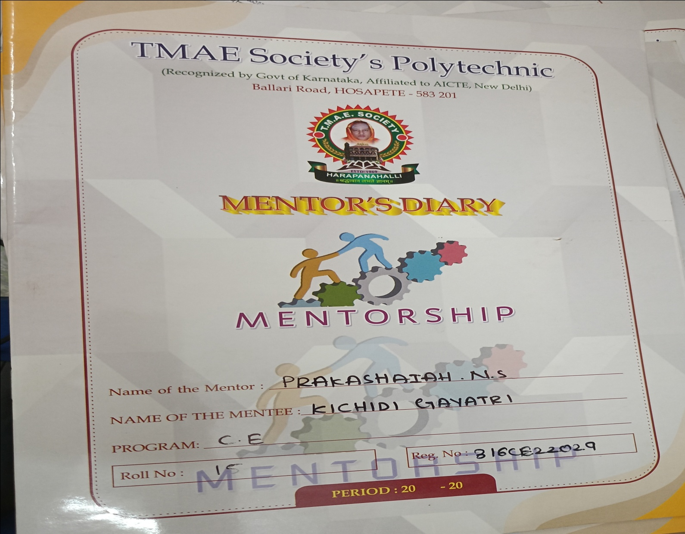
Mentorship dairy
1.Each faculty is divided with 15 students to maintain the Mentorship dairy.
2.Each faculty is counseling the students in their leisure time and at each Saturday afternoon.
Sample copy of Mentorship dairy,

Slide 50
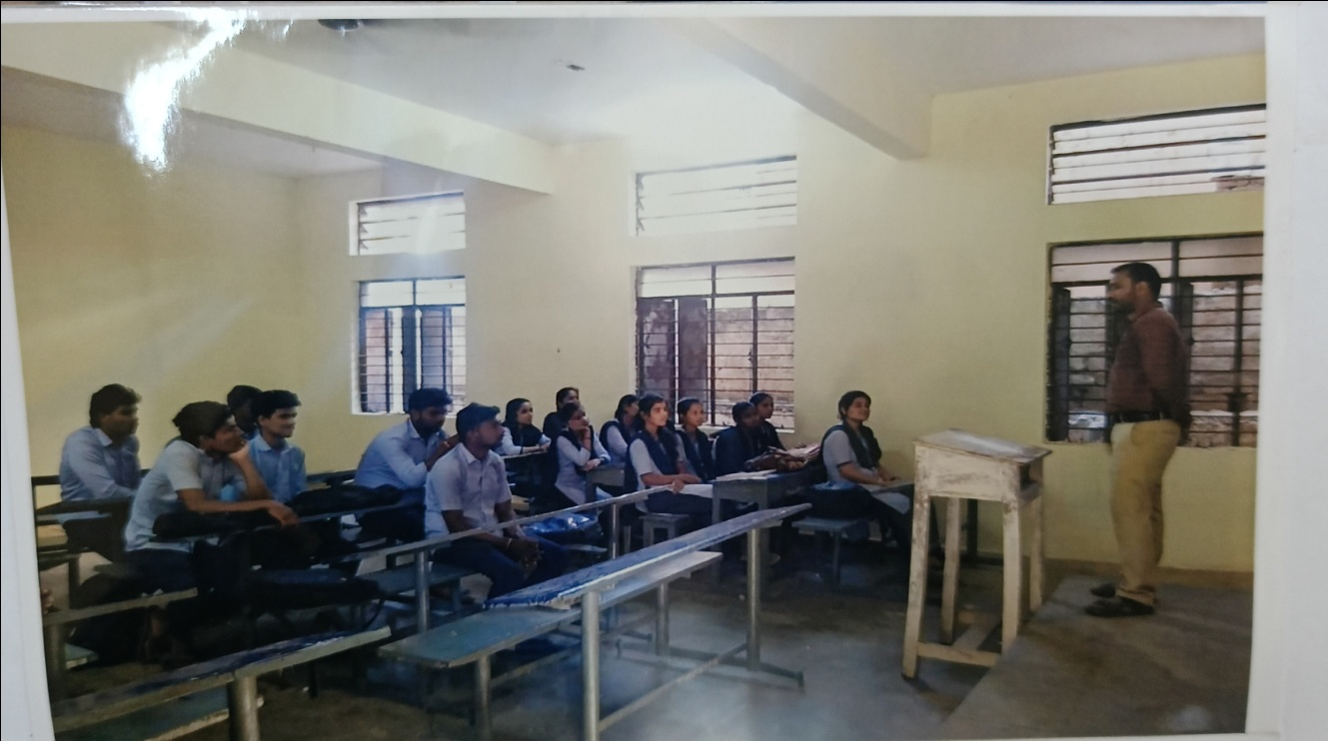
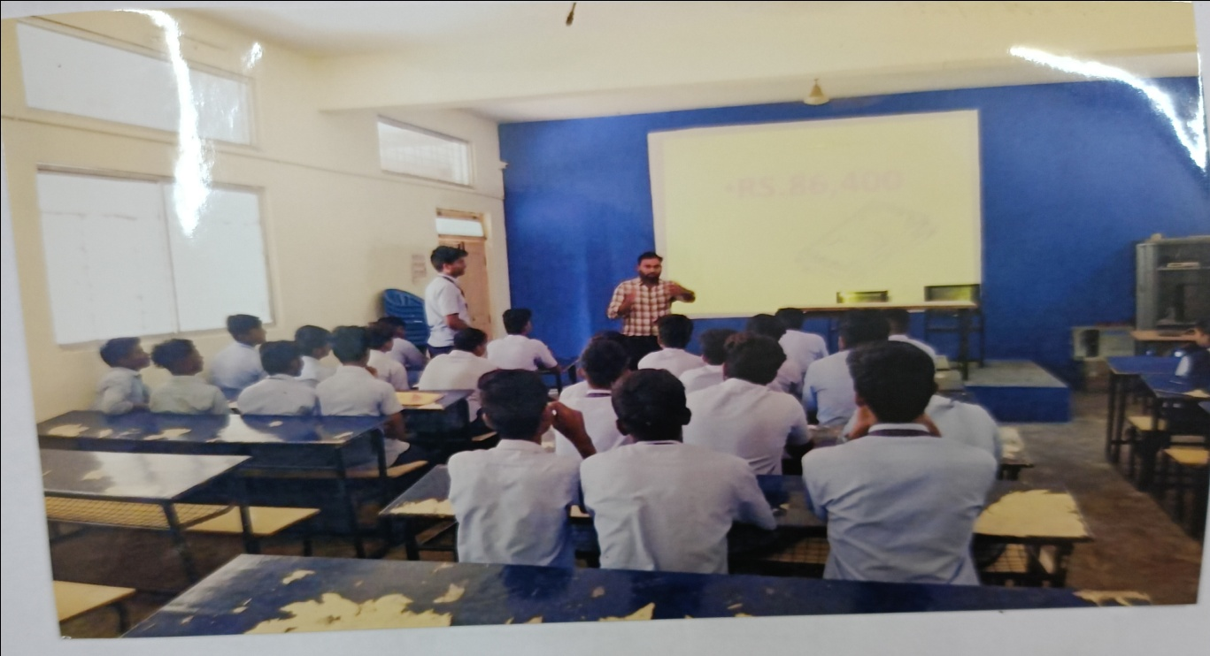
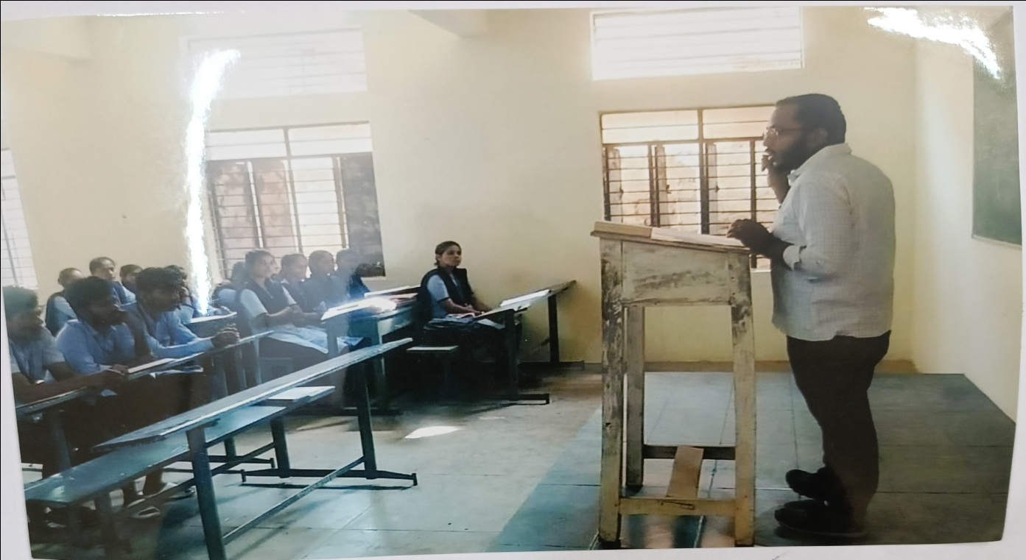
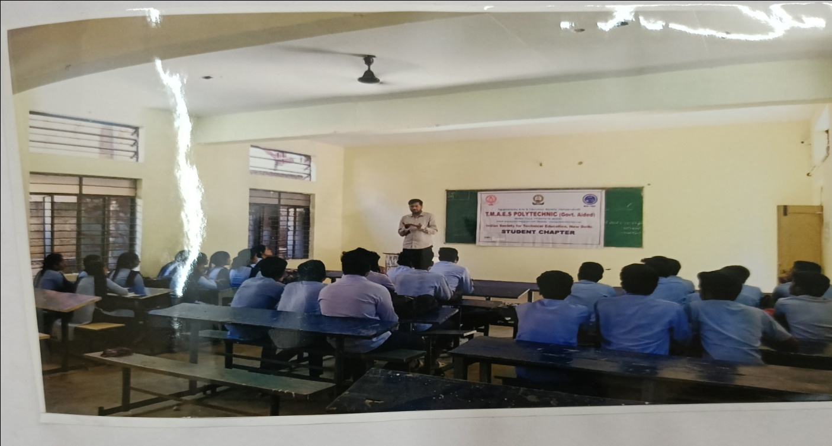
LECTURING, SEMINARS AND PRESENTATION DONE BY RESOURCE PERSON

Slide 51
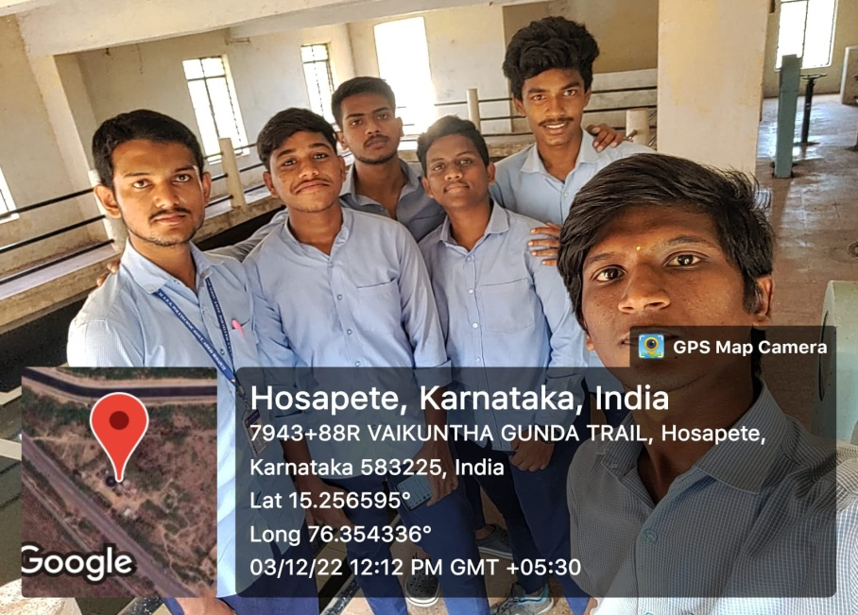
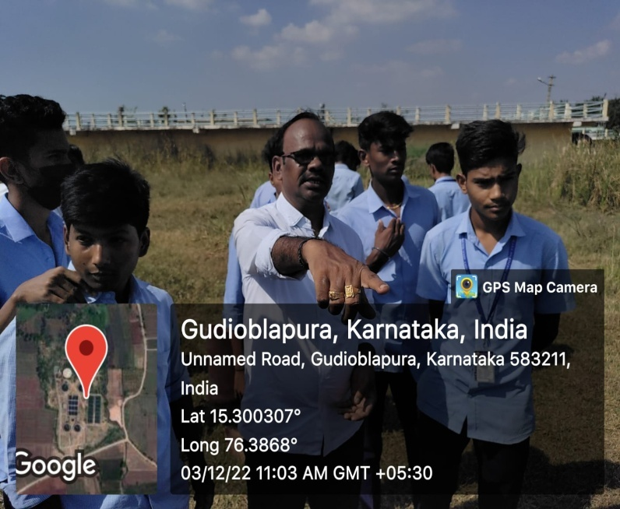
CURRICULAR ACTIVITIES
ANTI TOBACCO DAY
INDUSTRIAL VISIT
YOGA DAY CONDUCTED

Slide 52
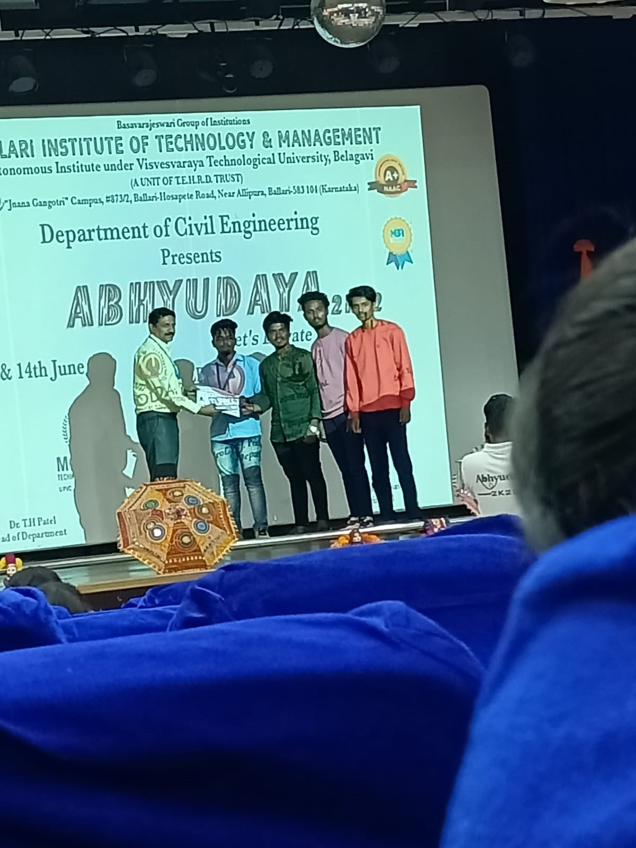
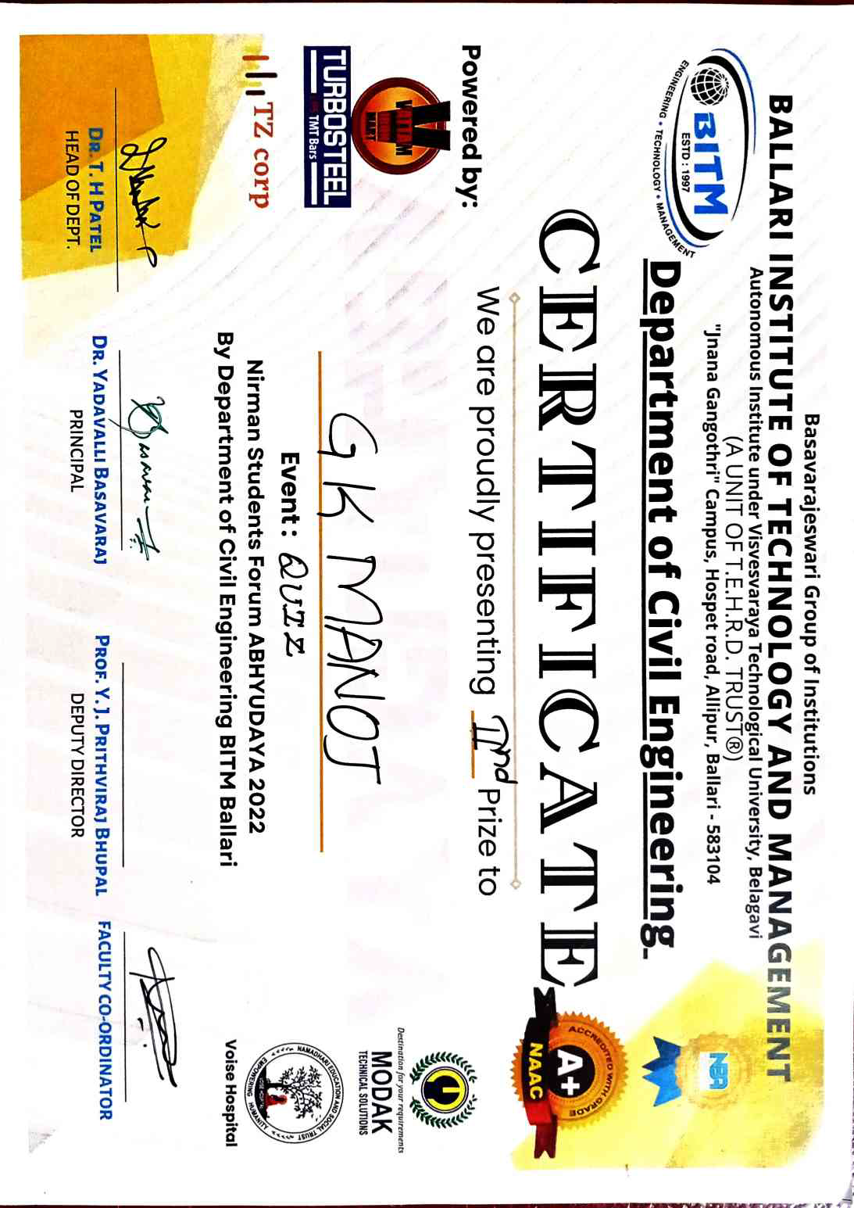
QUIZ COMPETITION
Sl No | Name | Place | Competition | Prize awarede
1. | Shivakumar M | BITM ENGG COLLEGE, BELLARI | ABHUDAYA QUIZ-2022 | SECOND PRIZE AWARDED
2. | G K manoj
3. | Shankar Pattar

Slide 53
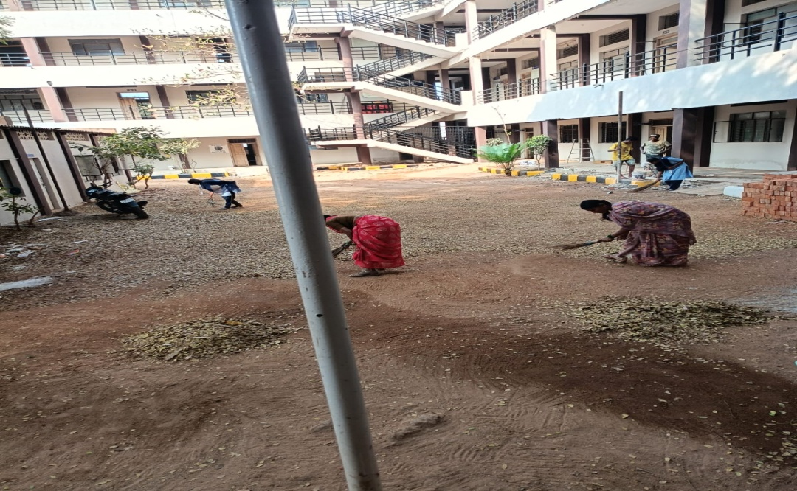
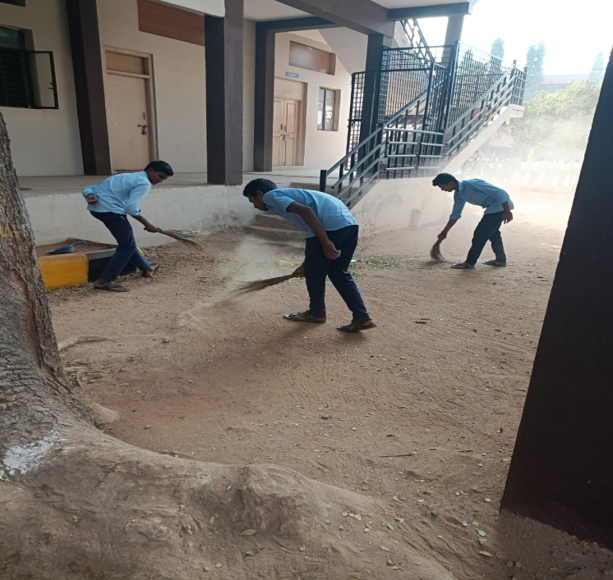
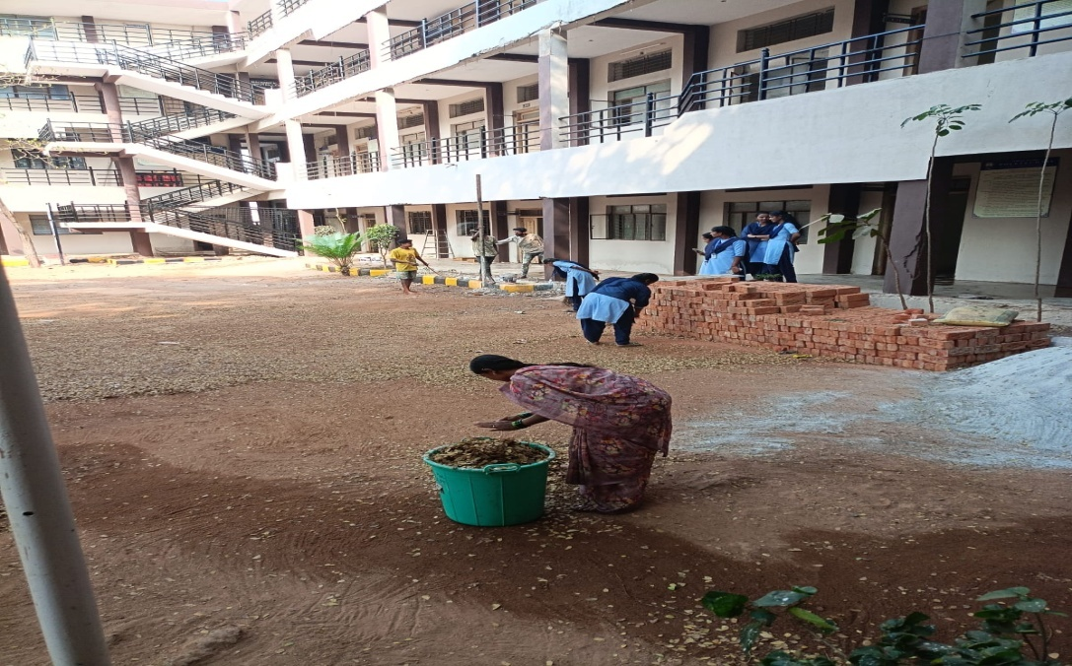
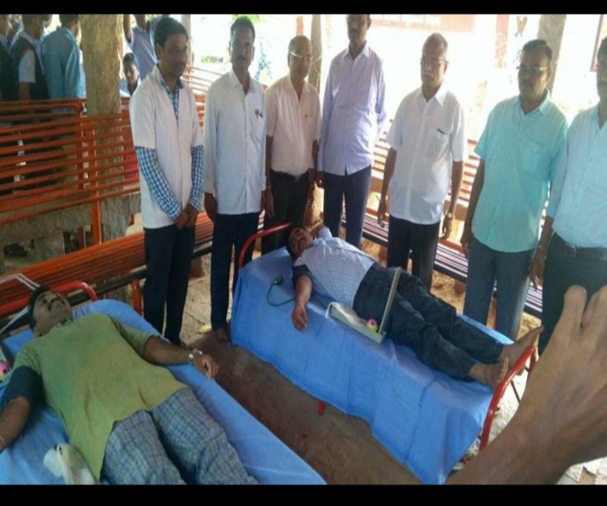
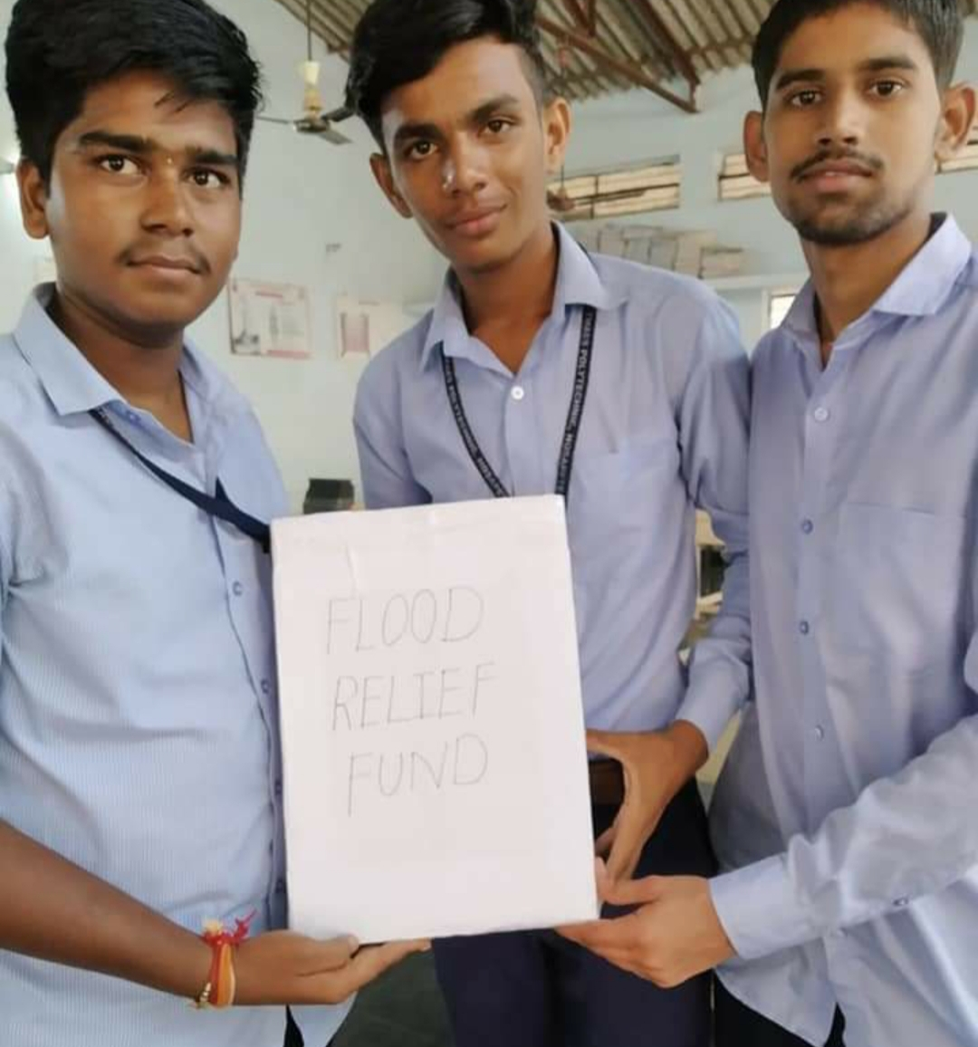
SWACHHA BHARAT ABHIANA DONE THROUGH DEPARTEMENT
BLOOD DONATION CAMP
FLOOD RFLIEF FUND CAMP BY CIVIL DEPARTEMENT

Slide 54
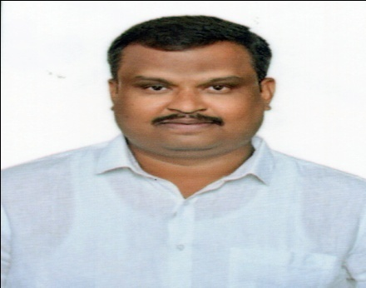
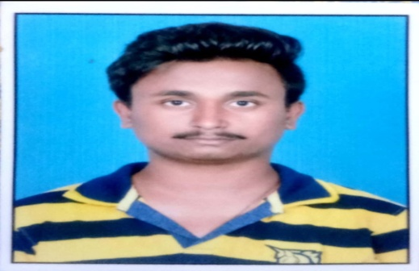
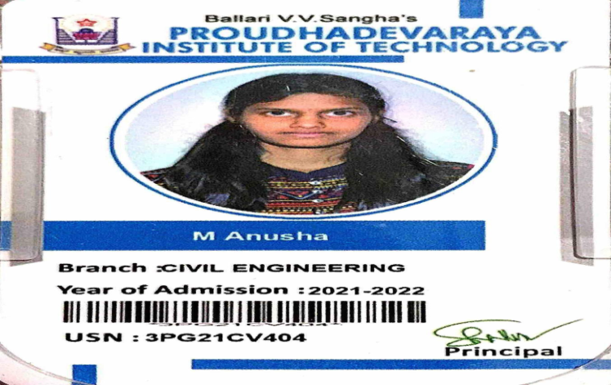
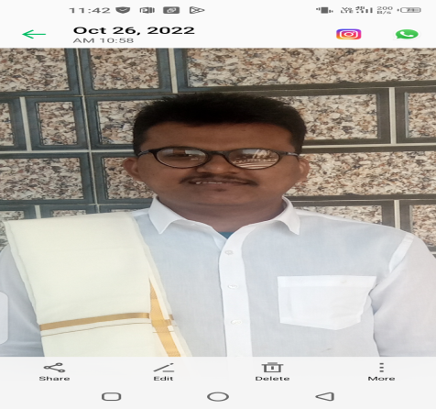
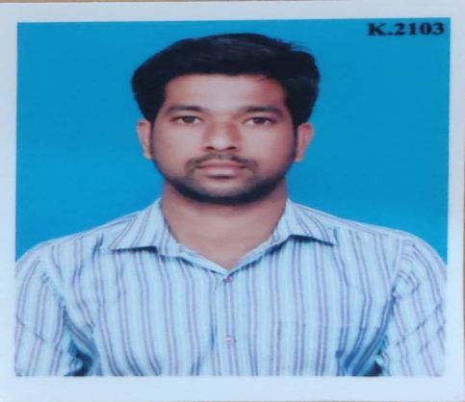
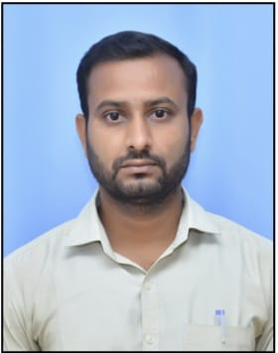
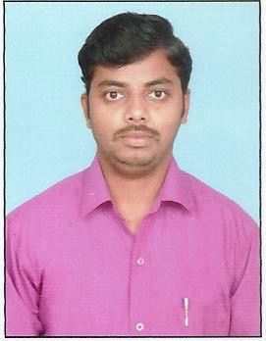
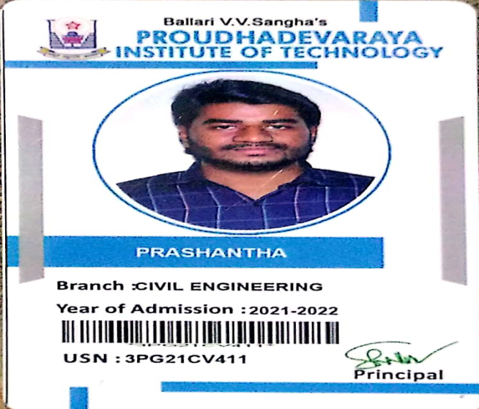
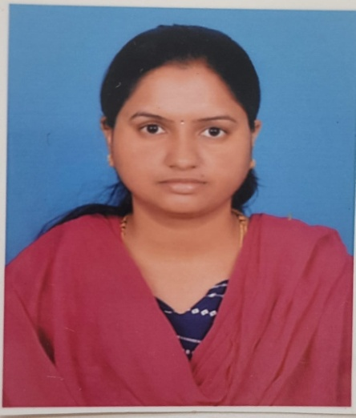
ASHOK K
316CE03001
AE , PASSED YEAR2006
Distinguished Alumni
SAGAR G
consulting civil engineer,
PASSED YEAR 2017
ANUSHA
PDIT ENGG COLLEGE
PASSED YEAR 2021-22
BALARA A Y
316CE13010
JE ,WRD YEAR2016-17
VINAYAKA M N
JE-RURAL WATER SUPPLY
PASSED YEAR 2009-10
SHVRAM K
316CE11051
JE , WATER SUPPLY DEPT
PASSED YEAR 2014
SRI GOURI C
316CE07038
JE ,YEAR2010
PRASHANTHA
PDIT ENGG COLLEGE
PASSED YEAR 2021-22

Slide 55
Part B
OBE Philosophy of Mechanical Engg. Department

Slide 56

Part B
OBE Philosophy of Civil Engineering Department

Slide 57
What is OBE
Outcome Based Education (OBE) is a student-centric learning methodology in which course delivery, assessment are planned to achieve stated objectives & outcomes.

Slide 58
OUTCOME BASED EDUCATION
OBE Process Implementation
OBE COMPONENTS
Vision & Mission
OBC
(Curriculum)
OBTL
(Teaching Learning)
OBA (Assessment)
Program Educational Objectives (PEOs)
Program Specific Outcomes (PSOs)
Program Outcomes(Pos)
Course 1
CO1,CO2,CO3...
Course 2
CO1,CO2,CO3...
Course n
CO1,CO2,CO3...

Slide 59
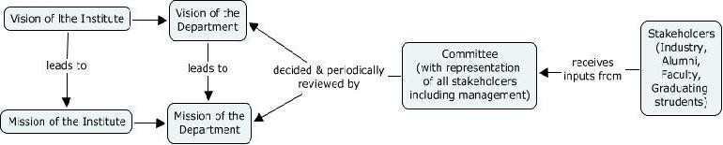
PROCESS FOR DEFINING VISION & MISSION

Slide 60
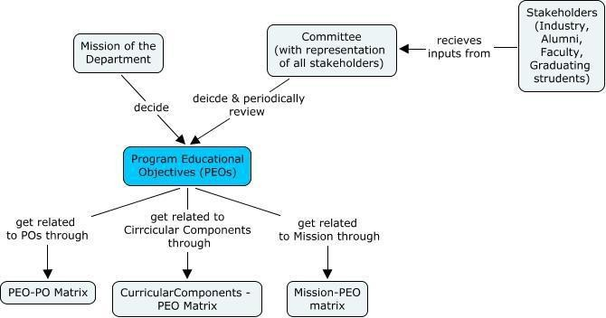
PROCESS FOR DEFINING PEO’s

Slide 61
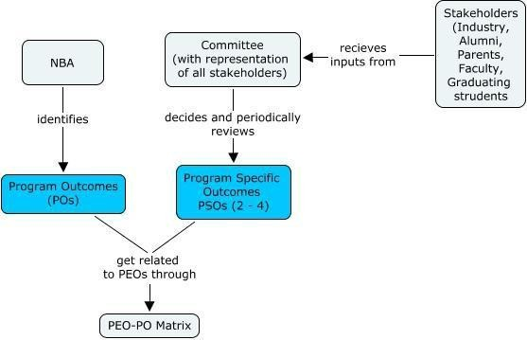
PROCESS FOR DEFINING PSO’s

Slide 62
Pedagogical Initiatives in Teaching Learning
Calendar of events
Course allotment order
Class Time Table & Individual Time Table
No. of Lecture hours available and planning for extra classes required if any, based on the Time Table & Calendar of Events
Preparation of lesson plan
Self prepared notes - Chapter Wise/ Section Wise/ Topic Wise
Preparation of Question Bank Chapter Wise/Section Wise/Topic Wise
Preparation of PPTs
List of URLs, Video links & other
Preparatory Phase
Execution Phase (Teaching and Delivery Phase) Pedagogies
Lecture
  White Board Teaching 2. Videos 3. Animations 4. Power Point Presentations 5. Models
  Invited Talks  Workshops
Industrial Visits  Inplant Training
Exhibits
Academic & Course File
Internal Audit Reports
Feedback Analysis
Students:
Internal Assessments 2.Assignments 3.Activities
4. Identification of Slow & Fast Learners & action thereon. 5.Mini Projects 6. Rubrics
Faculty:
  1. Internal Quality Audits 2. Students feedback on Teaching & Learning
Execution Phase Assessment
(Assessment)

Slide 63
OBE Assessment
Assessment Methodology
CO Assessment Tools
Direct Assessment Tools
Indirect Assessment Tools
CIE
Internship Training
Alumni Survey
Written test
Employer Survey
Activity/
assignment/
Project
Prog.Exit Survey
Multiple choice questions
Laboratory records
Open Book
SEE

Slide 64
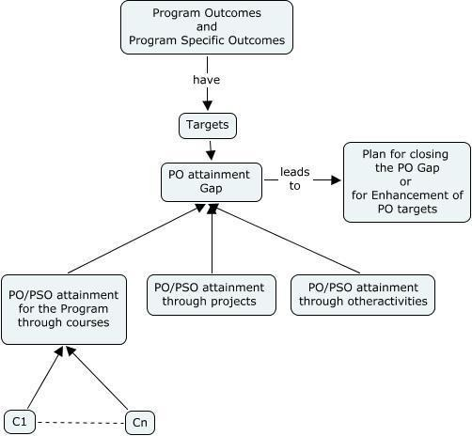
PO/PSO’s ATTAINMENT

Slide 65
Attainment of COs of the Course
Attainment of COs can be measured directly and indirectly
Direct attainment of COs can be determined from the performances of students in all the relevant assessment instruments.
Indirect attainment of COs can be determined from the course exit surveys.
The exit survey form should permit receiving feedback from students on
individual COs.
Computation of indirect attainment of COs may turn out to be complex; the percentage weightage to indirect attainment can be kept at a low percentage, say 10%.
Direct CO attainment
Semester End Examination (SEE) is conducted and evaluated by the SBTE
The Department will have access only to the marks obtained by each
student in the course
As the information on performance in SEE on each student in individual COs is not available, the Institution/Department has to take that attainment (percentage marks) for all COs of the course is the same.
The proportional weightages of CIE: SEE may be 40:60, 25:75 or 30:70.
The number of assessment instruments used for CIE is decided by the
instructor and/or Department and sometimes by the affiliating University

Slide 66
Strength of CO-PO/PSO Mapping
Attainment of a PO/PSO depends both on the attainment levels of associated COs and the strength to which it is mapped.
It is necessary to determine the level (mapping strength) at which a particular PO/PSO is addressed by the course.
Strength of mapping is defined at three levels: Low (1), Medium (2) and Strong (3)
Several methods can be worked to determine the strength of a PO/PSO, but Implementing them across a few hundred courses can become a burden
Strength of CO-PO/PSO Mapping Sample
A simple method is to relate the level of PO with the number of hours devoted to the COs which address the given PO.
If >40% of classroom sessions addressing a particular PO, it is considered that PO is addressed at Level 3
If 25 to 40% of classroom sessions addressing a particular PO, it is considered that PO is addressed at Level 2
If 5 to 25% of classroom sessions addressing a particular PO, it is considered

Slide 67

MAPPING STRENGTH CO’ WITH PO’S AND PSO’S FOR ONE SAMPLE SUBJECT, ENGG MECH AND STRENGTH OF MATERIALS
 | Course Outcome | POs | CL | Class Sessions | Lab Sessions (Hrs)
CO1 | Explain the potential impact of forces / stresses on structural elements / materials in a given condition. | PO1,PO2,PSO1,PSO2,PSO3 | U | 40 | -
CO2 | Calculate the moment of Inertia for a given symmetrical or asymmetrical geometric sections. | PO1,PO2,PO3,PSO1,PSO2,PSO3 | U/ap | 16 | -
CO3 | Calculate shear force and bending moments for different loading conditions and support conditions, draw the SFD & BMD and validate the analysis using Ansys software. | PO1,PO2,PO3,PSO1,PSO2,PSO3 | U/App | 24 | -
CO4 | Calculate bending and shear stresses in beams under different load conditions and validate the analysis using Ansys software. | PO1,PO2,PO3,PSO1,PSO2,PSO3 | U/Ap | 8 | -
CO5 | Calculate and validate the safety of a column for various given loads and end conditions. | PO1,PO2,PO3,PSO1,PSO2,PSO3 | U/Ap | 16 | -
Total Hours of instruction |  |  |  | 104 | -
PO’s & PSO’s | CO’s | Alloted Hours | Total Hours | Calculation regarding Mapping strength | Mapping strength
PO1 | CO1,CO2,CO3,CO4,CO5 | 104 | 104 |  | 3
PO2 | CO1,CO2,CO3,CO4,CO5 | 104 | 104 |  | 3
PO3 | CO2,CO3,CO4,CO5 | 64 | 104 |  | 3
PO4 | - | - | 104 | - | -
PO5 | - | - | 104 | - | -
PO6 | - | - | 104 | - | -
PO7 | - | - | 104 | - | -
PSO1 | CO1,CO2,CO3,CO4,CO5 | 104 | 104 |  | 3
PSO2 | CO1,CO2,CO3,CO4,CO5 | 104 | 104 |  | 3
PSO3 | CO1,CO2,CO3,CO4,CO5 | 104 | 104 |  | 3

Slide 68
Attainment of COs of the Course
Attainment of COs can be measured directly and indirectly
Direct attainment of COs can be determined from the performances of students
in all the relevant assessment instruments.
Indirect attainment of COs can be determined from the course exit surveys.
The exit survey form should permit receiving feedback from students on individual COs.
Computation of indirect attainment of COs may turn out to be complex; the percentage weightage to indirect attainment can be kept at a low percentage, say 10%.
Direct CO attainment
Semester End Examination (SEE) is conducted and evaluated by the SBTE
The Department will have access only to the marks obtained by each
student in the course
As the information on performance in SEE on each student in individual COs is
not available, the Institution/Department has to take that attainment (percentage marks) for all COs of the course is the same.
The proportional weightages of CIE: SEE may be 40:60, 25:75 or 30:70.
The number of assessment instruments used for CIE is decided by the
instructor and/or Department and sometimes by the affiliating University

Slide 69
RUBRICS FOR THEORY SUBJECTS
RUBRICS FOR ACTIVITY
Dimension | Beginning | Developing | Satisfactory | Good | Exemplary | Student Score
 | 4 | 8 | 12 | 16 | 20
 | Descriptor | Descriptor | Descriptor | Descriptor | Descriptor
 | Descriptor | Descriptor | Descriptor | Descriptor | Descriptor
 | Descriptor | Descriptor | Descriptor | Descriptor | Descriptor
 | Descriptor | Descriptor | Descriptor | Descriptor | Descriptor
Average

Slide 70
PATHWAY RUBRICS
Evaluation Parameters | 5 | 4 | 3 | 2 | 1 | Student Score
Identification of the main issues / problem | Identifies and understands all the main issues in the problem statement | Identifies and understands most of the main issues in the problem statement | Identifies and understands some of the issues in the problem statement | Identifies and understands a few of the issues in the problem statement | Identifies limited issues in the problem statement
Analysis of the issues | Insightful and thorough analysis of all the issues | Thorough analysis of most of the issues | Superficial analysis of some of the issues in the problem statement | Incomplete analysis of the issues | No analysis of the issue
Comments on effective solutions / strategies(The solution may be in the problem statement already or proposed by you) | Well documented, reasoned and pedagogically appropriate comments on solutions, or proposals for solutions, to all issues in the problem statement | Appropriate, well thought out comments about solutions, or proposals for solutions, to most of the issues in the problem statement | Superficial and / or inappropriate solutions to some of the issues in the problem statement | Little and/or inappropriate solutions to all of the issues in the problem statement | No action to all issues in the problem statement
Links to course learning and additional research | Excellent research into the issues with clearly documented Links to course learnings and beyond. | Good research and documented links to the materials read during the course | Limited research and documented links to any readings | Incomplete research and links to any reading. | No research or links to any reading
Total

Slide 71
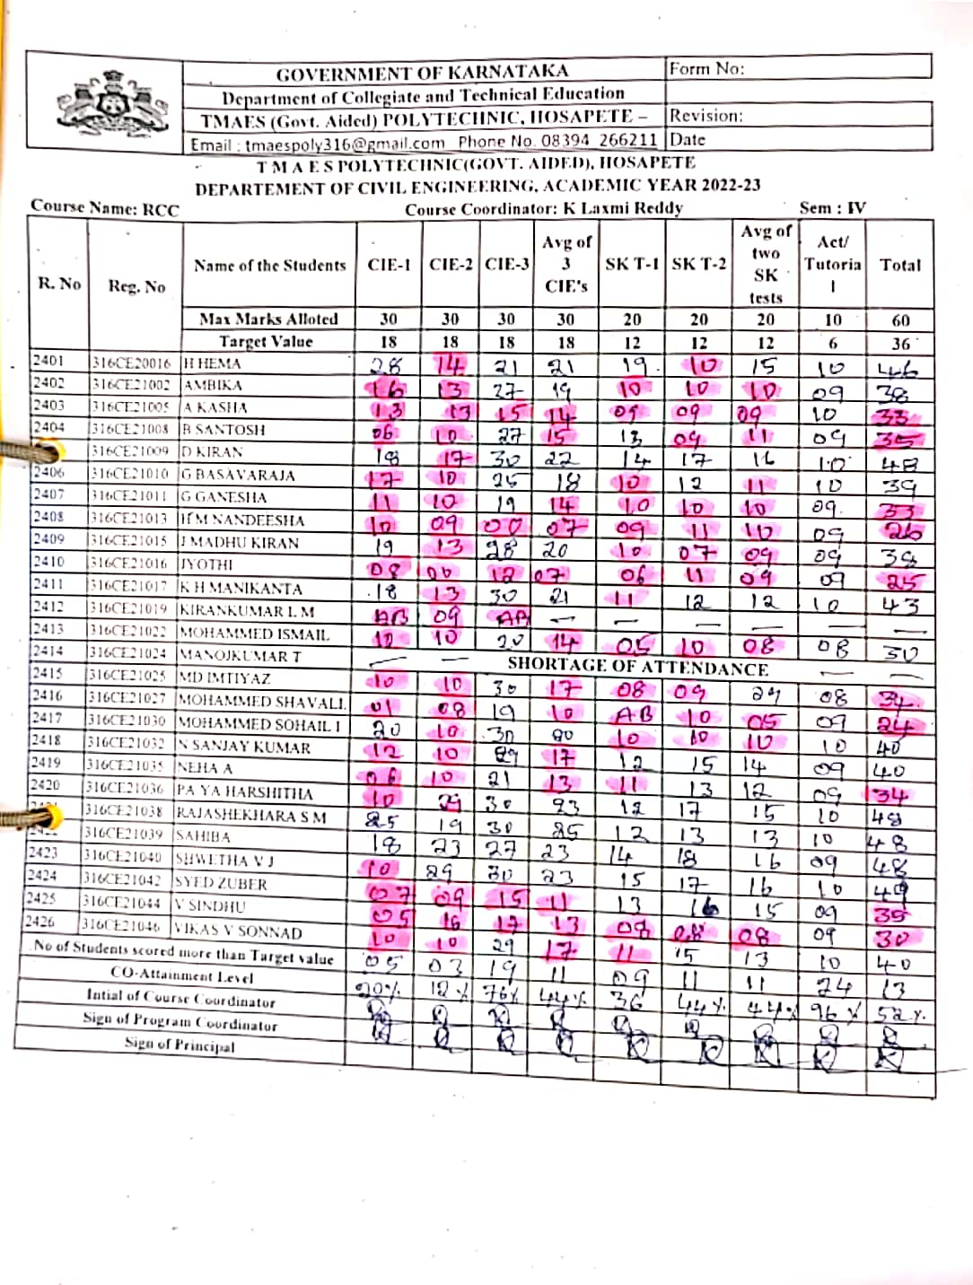
CIE REPORT FORMAT

Slide 72

Remedial class format

Slide 73

COURSE PLAN FORMAT

Slide 74

CIE QUESTION PAPER FORMAT

Slide 75
Thank You

