Slide 1
TMAES POLYTECHNIC (GOVT AIDED) (Recognized by Govt of Karnataka & Approved by AICTE, New Delhi.) HOSAPETE website: https://tmaespolytechnichpt.com DEPARTMENT OF MECHANICAL ENGG. First time Accreditation, Application No 6947/06/06/2022
HEARTLY
WELCOME
TO NBA TEAM
16/2/24
TO
18/2/24
Presented by
Sri T Naziruddeen

Slide 2
Contents
PART - A
1. Introduction
2. Department Achievements / Recognitions
3. Criteria 1: Vision, Mission & Program Educational Objectives.
4. Criteria 2: Program Curriculum & Teaching Learning Processes
5. Criteria 3: Program Outcomes & Course Outcomes
6. Criteria 4: Students Performance
7. Criteria 5: Faculty Information & contribution
8. Criteria 6: Faculties & Technical Support
9. Criteria 7: Continuous Improvement
PART - B
OBE Philosophy followed by the Department

Slide 3
PROGRAM IN A NUTSHELL
TMAES Polytechnic, Hosapete was established in the year 1983 and Diploma in mechanical engineering program was started in the year 1985 with an intake of 40 students .
Recognized by Government of Karnataka and approved by AICTE, New Delhi.
ACADEMIC YEAR | 1984-85 TO 1992-93 | 1993- 94 | 2005-06
INTAKE | 40 | 45 | 60

Slide 4
DEPARTMENT ACHEIVEMENTS
The program is ISO 9001:2015 certified.
100 % admission for the past 20 years.
Full fledged teaching faculty & technical supporting staff.
100% retention of staff.
60% of the students are already placed this year.
A fabrication workshop is setup in the college for making furnitures & students are given hands on training on welding & sheet metal works in this workshop.
The program is sanctioned a grant of Rs 10 Lakhs under MODROBS Scheme in 1998.
PROJECT FUNDED
SL NO | SCHEME | NAME OF THE PROJECT FUNDED | YEAR | AMOUNT
1 | MODROBS | COMPUTER INTEGRATED MANUFACTURING | 1998 | 10.00 Lakhs

Slide 5
FACULTY ACHIEVEMENTS
Program HOD is given additional charge as Vice Principal & Placement Officer.
HOD has conducted one day workshop on Accreditation process for faculty of Bapuji Polytechnic, Davangere.
HOD was invited as a judge by Education department to judge the district level model making competition of primary & high school teachers.
All the teaching faculty have set board question papers, were appointed as Chief Observer/Deputy Superintendent for various examinations conducted by BTE,Bengaluru.
All the teaching faculty & Foreman of the department are life members of ISTE.
HOD has published 3 books.

Slide 6
STUDENT ACHIEVEMENTS
60 students are members of the ISTE student chapter.
Topper students in board examinations year wise.
STUDENTS PROJECTS USED AS EXPERIMENTAL SETUP
SL NO | YEAR | REG NO | NAME | % OF MARKS
1 | 2020-21 | 316ME18023 | GAVIRAJ.R. | 88.32%
2 | 2021-22 | 316ME19010 | B.VIJAY KUMAR | 88.3%
3 | 2022-23 | 316ME20039 | P.VIGNESH | 94.75%

Slide 7
CRITERIA – 1 VISION, MISSION & PROGRAM EDUCATIONAL OBJECTIVES

Slide 8
VISION OF THE DEPARTMENT
DEPARTMENT VISION
INSTITUTE VISION
Empowering youth by imparting quality technical education and strive to prepare students with excellent technical skills
Create competent mechanical engineers to excel their skills in design, drawing, estimation and production.

Slide 9
MISSION OF THE DEPARTMENT
INSTITUTE MISSION
DEPARTMENT MISSION
To offer value added quality technical education & excellent academic training to our student.
To provide state of art infrastructure with latest facilities.
To strengthen industry institute interaction.
To impart quality technical education related to students by providing excellent teaching-learning environment and facilities to enhance skills in various fields of mechanical engineering.
To provide experiences in leadership, team work, communication – oral, written and hands-on activities through workshops, industrial visits and career guidance programs.
To build ethical values and social responsibilities in the minds of students so as to work towards the growth of the society.

Slide 10
PSO’s & PEO’s OF THE DEPARTMENT
PSO’s
PEO’s
The students will be able to apply necessary concepts in core areas of mechanical engineering.
The students will be able to develop & optimize solutions in computer aided drawing & manufacturing platforms.
The students will gain team spirit for working in a variety of manufacturing industries Automobile & power sectors as well as pursuing higher studies for contribution to research & development.
To prepare students for successful careers in industry to meet changing demands of their profession and instill a desire to learn continuously.
To provide students strong foundation in mathematics, science and sound basic theoretical knowledge along with required practical skills in the core areas of mechanical engineering to demonstrate technical excellence
To inculcate team work capabilities and communication skills among graduates of mechanical engineers.
To create awareness on environmental issues towards professional career advancement and need for life-long learning.

Slide 11
CRITERIA – 2 PROGRAM CURRICULUM & TEACHING LEARNING PROCESSES

Slide 12
COMPONENTS OF THE CURRICULUM (2020 CURRICULUM)
Component | Total Credits | Total Contact Hrs | % of Total Credits
General Studies | 4 | 6 | 3.1
Applied Science Courses | 8 | 10 | 6.1
Audit Courses | 6 | 6 | 4.5
Basic Engg & Technology Courses | 8 | 12 | 6.1
Departmental Core Courses | 90 | 124 | 68.2
Project / Internship Courses | 16 | 40 | 12
Total | 132 | 194 | 100

Slide 13
TEACHING LEARNING PROCESSES
Identified Curriculum Gaps
Identified Gap | Reasons
Knowledge of Mathematics & Science fundamentals | Mathematics & Science basics form the foundation for engineering & Engg Drawing course needs units & dimensions knowledge
Operation of Calculator | The third semester students are supposed to solve problems using calculators.
Communication skills & Personality Development | Diploma students have to communicate effectively while attending campus interviews.

Slide 14
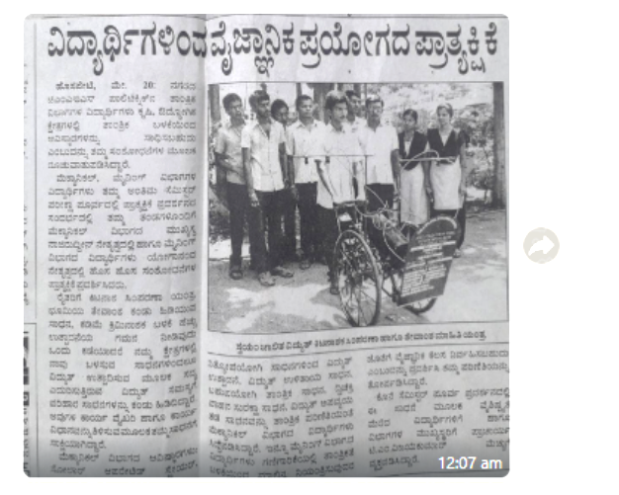
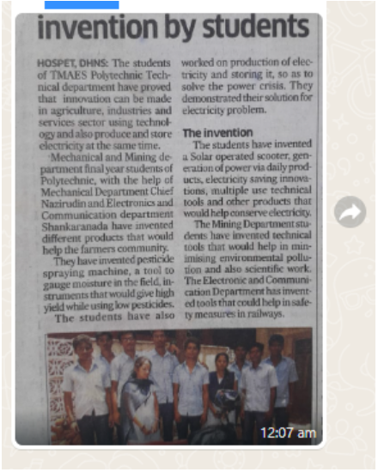
STUDENT PROJECT RECOGNITIONS

Slide 15
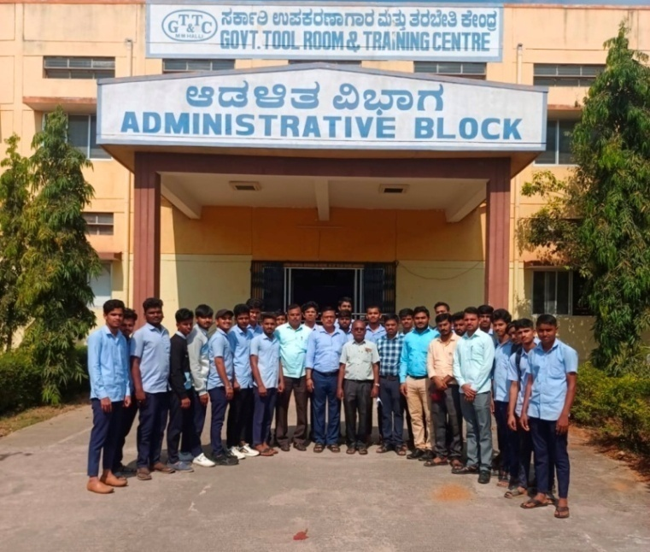
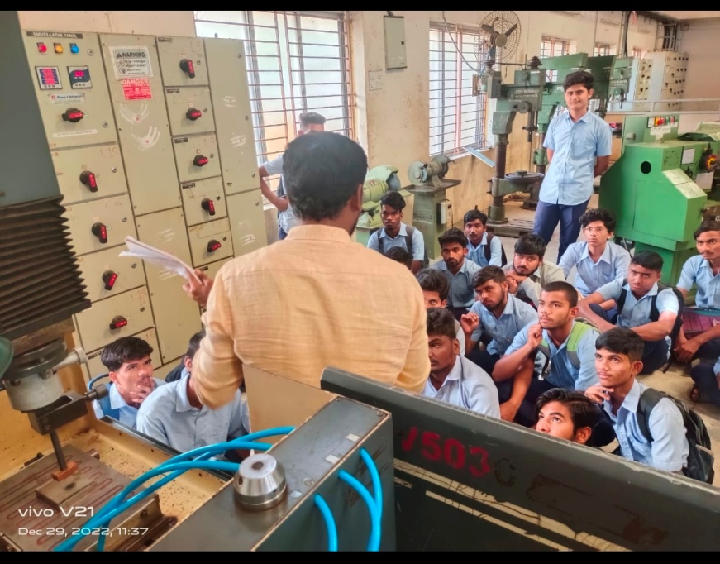
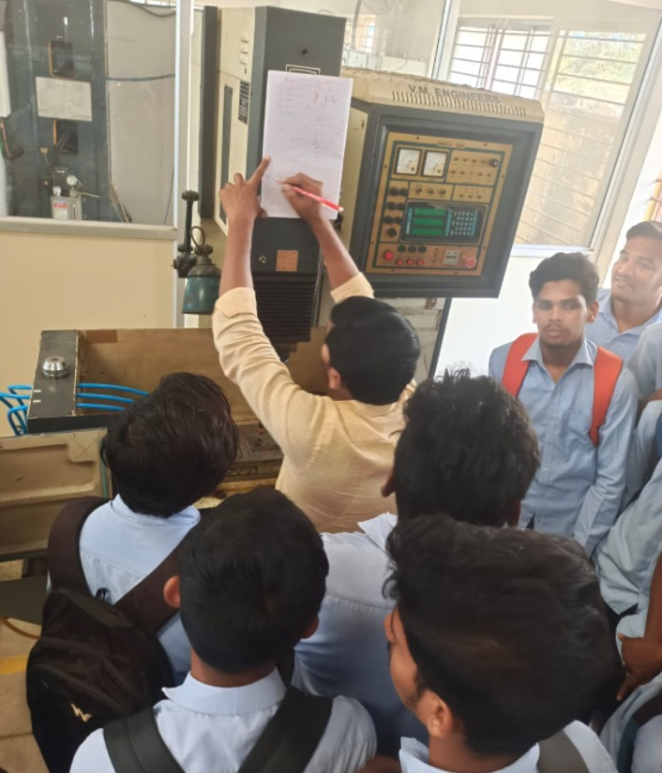
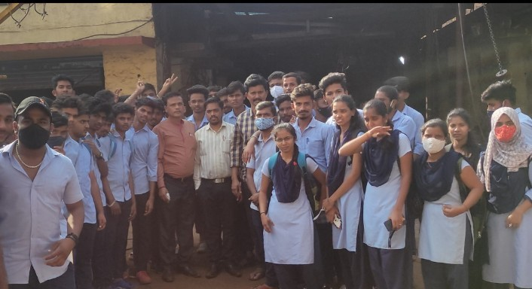
INDUSTRIAL VISITS

Slide 16
CRITERIA – 3 COURSE OUTCOMES & PROGRAM OUTCOMES

Slide 17
PROGRAM OUTCOMES

Slide 18
PROGRAM SPECIFIC OUTCOMES
PSO | STATEMENT
PSO1 | The students will be able to apply necessary concepts in core areas of mechanical engineering
PSO2 | The students will be able to develop & optimize solution in computer aided drawing & manufacturing platforms
PSO3 | The students will gain team spirit for working in a variety of manufacturing industries, Automobile & power sectors as well as pursuing higher studies for contribution to research & development/

Slide 19
CO-PO MAPPING
Course Name & Code: Mechanics of Machines, 20ME31P
Course Outcome | Statements
C201.1 | Analyse Simple Stresses and Strains on given Structural member that is subjected to tensile, Compressive and Shear loads by using Destructive Test.
C201.2 | Draw Shear force Diagram (SFD) and Bending moment Diagram (BMD) and Also, Analyse Bending Stresses in a Beam using Finite element methods(FEM) software
C201.3 | Demonstrate the application of finite element formulations to solve both One dimensional and Two dimensional Problems.
C201.4 | Demonstrate the application of FEM software for Validation of both One dimensional and Two dimensional Problems
Course | PO1 | PO2 | PO3 | PO4 | PO5 | PO6 | PO7
C201.1 | 3
C201.2 |  | 3
C201.3 | 3 | 3 |  | 2
C201.4 | 3 | 3 |  | 2 |  |  | 3
Average | 3 | 3 |  | 2 |  |  | 3

Slide 20
OBE Assessment
Assessment Methodology
CO Assessment Tools
Direct Assessment Tools
Indirect Assessment Tools
Internal Assessment
Internship Training
Alumni Survey
Written test
Employer Survey
Activity
Project
Prog.Exit Survey
Multiple choice questions
Laboratory records
Open Book
SEE

Slide 21
CO ATTAINMENT
Sl No. | SEM | Course | Course No | CO1 | CO2 | CO3 | CO4 | CO5 | CO6
1 | 1 | Engg. Maths | C101 | 51.4 | 75.37 | 75.14 | 79.7 | 79.7
2 |  | MFE | C102 | 51.4 | 75.37 | 75.14 | 79.7 | 79.7
3 |  | C SKILLS | C103 | 93.04 | 95.81 | 95.4 | 95.4
4 |  | CAED | C104 | 96.8 | 96.43 | 92.34 | 90.75
5 | 2 | PMS | C105 | 51.4 | 75.37 | 75.14 | 79.7 | 79.7 | 79.7
6 |  | SA LAB | C106 | 93.04 | 95.81 | 95.4 | 95.4
7 |  | FEEE | C107 | 93.04 | 95.81 | 95.4 | 95.4 | 95.4
8 |  | IT SKILLS | C108 | 96.8 | 96.43 | 92.34 | 90.75 | 90.75
9 |  | MWP-1 | C109 | 96.8 | 96.43 | 92.34 | 90.75
10 | 3 | MOM | C201 | 80.91 | 77.41 | 92.53 | 90.1
11 |  | MTT | C202 | 86.12 | 69.4 | 88.31 | 86.08
12 |  | MT | C203 | 89.22 | 80.72 | 85.46 | 83.16
13 |  | FPE | C204 | 86.12 | 69.4 | 88.31 | 86.08
14 | 4 | OM | C205 | 93.2 | 87.66 | 94.02 | 71.56
15 |  | CNCP&M | C206 | 88.04 | 65.04 | 94.24 | 96.44
16 |  | PDD | C207 | 54.32 | 86.87 | 73.15 | 77.87
17 |  | EIA | C208 | 97.71 | 87.53 | 99.22 | 87.87
18 | 5 | AMT | C301 | 98.32 | 90.6 | 100 | 88.89
19 | 6 | INTERNSHIP / PROJECT | C302 | 98.32 | 90.6 | 100

Slide 22
PO ATTAINMENT
Sl No. | Course No | PO1 |  | PO2 |  | PO3 |  | PO4 |  | PO5 |  | PO6 |  | PO7
 |  | TL | AL | TL | AL | TL | AL | TL | AL | TL | AL | TL | AL | TL | AV
1 | C101 | 3.0 | 2.32 | 3.0 | 2.32 | 3.0 | 2.32 | 3.0 | 2.32 |  |  |  |  | 1.0 | 0.77
2 | C102 | 3.0 | 2.32 | 3.0 | 2.32 | 3.0 | 2.32 | 3.0 | 2.32 |  |  |  |  | 1.0 | 0.77
3 | C103 |  |  |  |  |  |  |  |  |  |  | 3.0 | 2.84 | 3.0 | 2.87
4 | C104 | 3.0 | 2.82 |  |  |  |  | 3.0 | 2.82
5 | C105 | 3.0 | 2.32 | 3.0 | 2.32 | 2.0 | 1.42 | 1.0 | 0.8 | 2.0 | 1.6 | 1.0 | 0.65 | 3.0 | 2.42
6 | C106 | 3.0 | 2.82 | 3.0 | 2.82 |  |  | 3.0 | 2.82 | 3.0 | 2.82 |  |  | 3.0 | 2.82
7 | C107 | 3.0 | 2.82 |  |  |  |  | 3.0 | 2.82
8 | C108 | 3.0 | 2.82 |  |  |  |  | 3.0 | 2.82 |  |  |  |  | 3.0 | 2.82
9 | C109 | 3.0 | 2.82 |  |  |  |  | 3.0 | 2.82
10 | C201 | 3.0 | 2.64 | 3.0 | 2.6 |  |  | 3.0 | 2.74 |  |  |  |  | 3.0 | 2.7
11 | C202 | 3.0 | 2.82 | 3.0 | 2.82 |  |  | 3.0 | 2.82 | 1.0 | 0.74 |  |  | 2.0 | 1.82
12 | C203 | 3.0 | 2.54 |  |  |  |  | 3.0 | 2.55 |  |  |  |  | 3.0 | 2.53
13 | C204 | 3.0 | 2.62 | 1.0 | 0.89 |  |  | 3.0 | 2.6 |  |  |  |  | 3.0 | 2.62
14 | C205 | 3.0 | 2.85 | 2.0 | 1.91 |  |  | 1.0 | 0.98 | 1.0 | 0.98 |  |  | 3.0 | 2.9
15 | C206 | 3.0 | 2.72 | 1.0 | 0.84 |  |  | 3.0 | 2.79 |  |  |  |  | 3.0 | 2.86
16 | C207 | 1.0 | 0.81 |  |  | 2.0 | 2.52 | 3.0 | 2.52 |  |  |  |  | 2.0 | 1.65
17 | C208 | 3.0 | 2.92 | 3.0 | 2.92 |  |  |  |  |  |  |  |  | 2.0 | 1.94
18 | C301 | 3.0 | 2.97 | 3.0 | 2.98 |  |  | 3.0 | 2.92 | 3.0 | 2.92 |  |  | 2.0 | 1.99
19 | C302 | 3.0 | 2.97 | 3.0 | 2.97 | 3.0 | 2.97 | 3.0 | 2.97 | 3.0 | 2.97 | 3.0 | 2.97 | 3.0 | 2.97
Average |  | 2.88 | 2.61 | 2.58 | 2.32 | 2.60 | 2.32 | 2.76 | 2.53 | 2.17 | 2.01 | 2.33 | 2.15 | 2.5 | 2.33

Slide 23
PSO ATTAINMENT
Sl No. | SEM | Course | Course No | PSO1 |  | PSO2 |  | PSO3
 |  |  |  | Target | Achieved | Target | Achieved | Target | Achieved
1 | 1 | Engg. Maths | C101
2 |  | MFE | C102 | 3 | 2.82
3 |  | C SKILLS | C103
4 |  | CAED | C104 | 3 | 2.82 | 3 | 2.82
5 | 2 | PMS | C105 |  |  |  |  | 3 | 2.82
6 |  | SA LAB | C106
7 |  | FEEE | C107
8 |  | IT SKILLS | C108
9 |  | MWP-1 | C109
10 | 3 | MOM | C201 | 3 | 2.56
11 |  | MTT | C202 | 3 | 2.82
12 |  | MP | C203 | 3 | 2.54
13 |  | FPE | C204 | 3 | 2.62
14 | 4 | OM | C205 | 3 | 2.85
15 |  | CNCP&M | C206 | 3 | 2.72
16 |  | PDD | C207 | 3 | 2.50
17 |  | EIA | C208 | 3 | 2.93
18 | 5 | AMT | C301 | 3 | 2.98 |  |  | 3 | 2.92
19 | 6 | INTERNSHIP/ PROJECT | C302 | 3 | 2.94 |  |  | 3 | 2.94

Slide 24
CRITERIA – 4 STUDENT PERFORMANCE

Slide 25
DETAILS OF SANCTIONED INTAKE & STUDENTS ADMITTED
Item | 2023-24 (CAY) | 2022-23 (CAYm1) | 2021-22 (CAYm2) | 2020-21 (CAYm3) | 2019-20 (CAY4) | 2018-19 (CAYm5)
Sanctioned intake strength of the program (N) | 60 | 60 | 60 | 60 | 60 | 60
Total number of students, admitted through state level counselling (N1) | 58 | 60 | 60 | 60 | 60 | 60
Number of Students, admitted through Institute level quota (N2) | 9 | 3 | 3 | 1 | 1 | 1
Number of students, admitted through Lateral Entry (N3) | 6 | 6 | 5 | 4 | 7 | 9
Total number of students admitted in the programme (N1+N2+N3) | 73 | 69 | 68 | 65 | 68 | 70
Enrolment Ratio =( N₁ + N₂ + N₃ )/N *100 | 100 | 100 | 100 | 100 | 100 | 100
Average | 100

Slide 26
SUCCESS RATE WITHOUT BACKLOGS
Item | LYG (2020-21) | LYGm1 (2019-20) | LYGm2 (2018-19)
Total Number of students (X) (admitted through state Level counselling + admitted Through institute on level quota +Admitted through Lateral entry ) (N1+N2+N3) | 65 | 68 | 70
Number of students who have graduated without backlogs In the stipulated period (Y) | 24 | 20 | 11
Success Index [Sl =Y / X] | 0.369 | 0.294 | 0.157
Average SI | 0.273
Success Rate | 10.8

Slide 27
SUCCESS RATE IN STIPULATED PERIOD
Item | LYG (2020-21) | LYGm1 (2019-20) | LYGm2 (2018-19)
Total Number of students (X) (admitted through state Level counselling + admitted Through institute on level quota +Admitted through Lateral entry ) (N1+N2+N3) | 65 | 68 | 70
Number of students who have passed In the stipulated period (Y) | 47 | 30 | 29
Success Index [Sl =Y / X] | 0.723 | 0.441 | 0.414
Average SI | 0.526
Success Rate | 10.52

Slide 28
ACADEMIC PERFORMANCE IN FIRST YEAR
Academic Performance | 2022-23(CAYm1) | 2021-22 (CAYm2) | 2020-21 (LGY)
Mean of CGPA or mean percentage of all successful students(X) | 63.28 | 6.536 | 7.295
Total number of successful students(Y) | 45 | 60.00 | 58.00
Total number of students appeared in the examination(Z) | 45 | 62.00 | 61.00
API [ X*(Y/Z) ]: | 6.328 | 6.325 | 6.936
Average API | 6.529

Slide 29
ACADEMIC PERFORMANCE IN SECOND YEAR
Academic Performance | 2021-22 ( CAYm2) | 2020-21 (LYG) | 2019-20 (LYGm1)
Mean of CGPA or mean percentage of all successful students(X) | 6.233 | 7.323 | 6.609
Total number of successful students(Y) | 59 | 60.00 | 58.00
Total number of students appeared in the examination(Z) | 62 | 60.00 | 58.00
API [ X*(Y/Z) ]: | 5.93 | 7.323 | 6.609
Average API | 6.620

Slide 30
ACADEMIC PERFORMANCE IN FINAL YEAR
Academic Performance | 2020-21 (LYG ) | 2019-20 ((LYGm1) | 2018-19 (LYGm2)
Mean of CGPA or mean percentage of all successful students(X) | 8.677 | 7.266 | 7.157
Total number of successful students(Y) | 47 | 32.00 | 30.00
Total number of students appeared in the examination(Z) | 59 | 58.00 | 50.00
API [ X*(Y/Z) ]: | 6.912 | 4.00 | 4.294
Average API | 5.068

Slide 31
PLACEMENT & HIGHER STUDIES
Item | 2020-21 (LYG) | 2019-20 (LYGm1) | 2018-19 (LYGm2)
Total No of Final Year Students(N) | 59.00 | 58.00 | 50.00
No of students placed in the companies or government sector(X) | 16 | 26 | 20.00
No of students admitted to higher studies (Y) | 8 | 12 | 15.00
No. of students turned entrepreneur in the respective field of engineering/technology (Z) | - | - | -
Placement Index [((1.25 * X) + Y + Z ) / N ] : | 0.475 | 0.767 | 0.8
Sl No | Program | 2023-24 | 2022-23 | 2021-22
 |  | Placed | Placed | Placed
1 | Mechanical | 32 | 20 | 25

Slide 32
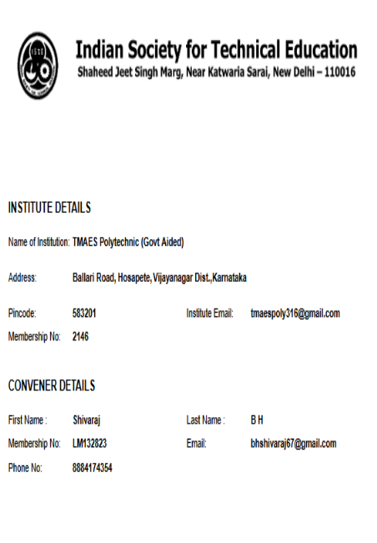
PROFESSIONAL SOCIETIES
Sl. No | NAMEOFTHESTAFF | Designation | Depart ment | MISTE NUMBER
1 | T NAZIRUDDEEN | Sl. Gr. Lecturer | MECH | LM132824
2 | GUDUDAPPA T | Sl. Gr. Lecturer | MECH | LM89981
3 | PRAKASH C S | Sl. Gr. Lecturer | MECH | LM89984
4 | MALIPATIL MAHESHAGOUDA | Sl. Gr. Lecturer | MECH | LM45579
5 | VENKATESH D | Sl. Gr. Lecturer | MECH | LM89980
6 | GAVISIDDAPPA | Sl. Gr. Lecturer | MECH | LM89982
7 | PUNDALEEK MALABASARI | Sl. Gr. Lecturer | MECH | LM89979
8 | MALLIKARJUNA KP | Sl. Gr. Lecturer | MECH | LM89978
9 | YOGANANDA T L | Sl. Gr. Lecturer | MECH | LM132822

Slide 33
CRITERIA – 5 FACULTY INFORMATIONS & CONTRIBUTIONS

Slide 34
FACULTY LIST 2023-24
SL NO | NAME | DESIGNATION | QUALIFICATION
1 | T.Naziruddeen | HOD | BE(Mech)
2 | T.Gududappa | Sl. Gr. Lecturer | BE(Mech)
3 | C.S.Prakash | Sl. Gr. Lecturer | BE(Mech)
4 | Maheshagouda.M | Sl. Gr. Lecturer | BE(Mech)
5 | D.Venkatesh | Sl. Gr. Lecturer | BE(Mech)
6 | Gavisiddappa | Sl. Gr. Lecturer | BE(Mech)
7 | Pundaleek.M. | Sl. Gr. Lecturer | ME (Prodn Tech)
8 | K.P.Mallikarjuna | Sl. Gr. Lecturer | BE (Mech)
9 | T.Anand | Lecturer | MSc (Maths)
10 | Mahesh Budha | Lecturer | MSc (CSc)
11 | Dr Shivaraj.B.H | Sl. Gr. Lecturer | MA (English),PhD
12 | B.Lingappa | Sl. Gr. Lecturer | BE (E&E)
13 | Rekha Hanchati | Lecturer | BE (C Sc)
14 | Yamuna Kulkarni | Lecturer | MA (Kannada)
BRANCH | QUALIFICATION | NOS
MECH | ME | 1
MECH | BE | 7
ELECT | BE | 1
CS | BE | 1
SCIENCE | MSc (Maths) | 1
SCIENCE | MSc(CSc) | 1
SCIENCE | MA (English), PhD | 1
SCIENCE | MA (Kannada) MEd | 1

Slide 35
STUDENT FACULTY RATIO
Year | N | F | SFR = N/F
CAY(2023-24) | 192 | 9.00 | 21.33
CAYm1(2022-23) | 192 | 10.00 | 19.2
CAYm2(2021-22) | 192 | 10.00 | 19.2
Average SFR | 19.91

Slide 36
FACULTY INFORMATION
Academic Year | Total number of regular faculty in the department | Total number of contractual faculty in the department
CAY (2023-24) | 14 | 0
CAYm1(2022-23) | 15 | 0
CAYm2(2021-22) | 15 | 0

Slide 37
FACULTY QUALIFICATION INDEX
Ac. Year | X | Y | F | FQ = 2 x [(10X + 7Y) / F)]
2023 – 24 | 2 | 9 | 8.00 | 20.75
2022 – 23 | 3 | 9 | 8.00 | 23.25
2021 - 22 | 3 | 9 | 8.00 | 23.25

Slide 38
FACULTY RETENTION
Description | 2021-22 (CAYm2) | 2022-23 (CAYm1) | 2023-24 (CAY)
No of Faculty Retained | 15 | 15 | 14
Total No of Faculty | 15 | 15 | 14
% of Faculty Retained | 100 | 100 | 100

Slide 39
FACULTY CONTRIBUTIONS
BOOKS PUBLISHED BY HOD:
SL NO | TITLE OF THE BOOK | YEAR OF PUBLICATION
1 | QUESTION BANK FOR III & V SEM MECHANICAL | 2006
2 | BOOST TO MINDS | 2013
3 | WORKSHOP TECHNOLOGY | 2016

Slide 40
FDP/STTP ATTENDED BY FACULTY
Sl. No. | Academic Year | Total number of Programs attended
1 | 2023-24 | 1
2 | 2022-23 | 2
3 | 2021-22 | 2
Sl. No. | Date | Name of the Event | Name of the Resource Person
2023-24
1 | 21/8/23 to 25/8/23 | FDP on 3D Printer | G.K.Shivaprasad, Soft Academy, Hosapete
2022-23
1 | 12/8/22 to 17/8/22 | Online FDP on Accreditation process for Diploma Engineering. | Prof Dr S.G.Anuradha, Prof Raghu Kumar.K.S, RYMEC, Ballari
2 | 14/10/22 to 8/10/22 | Online FDP on Automation Technology | G.K.Shivaprasad, Soft Academy, Hosapete
2021-22
1 | 18/1/22 to 22/1/22 | Online FDP on Preparation of SAR for NBA | Dr Md Rafiq, UBDTCE, Davangere Dr Veergangadhara Swamy, RYMEC, Ballari,
2 | 22/11/21to 26/11/21 | Online FDP on CNC Machines | G.K.Shivaprasad,, Soft Academy, Hosapete

Slide 41
FACULTY PERFORMANCE APPRAISAL AND
DEVELOPMENT SYSTEM
03
01
05
Faculty
Head of the department
Verifies and puts signature and documents the same.
Appraisal Form
Principal
Roles
Responsibilities
Contribution to the Dept
in previous year results
Contribution to improve campus placement/higher education
02
04

Slide 42
CRITERIA – 6 FACILITIES & TECHNICAL SUPPORT

Slide 43
AVAILABILITY OF CLASS/FACULTY ROOMS
Room Description | Number Of Rooms | Usage | Rooms Equipped with
Drawing Hall | 01 | Allotted for all Students who are having Engg. Drawing | Green board, adequate Lighting, podium, fans, Benches
HOD Room | 01 | Allotted for HOD | Well furnished with Table and chair, fan Tube Light, internet access point
Mechanical Faculty Room | 01 | Allotted for Faculty | Individual table and chair, Racks, for staff
Class Rooms | 03 | For 1,3 &5th Sem Students (For even sem also) | Green board, adequate Lighting, podium, fans, Benches

Slide 44
TECHNICAL MAN POWER SUPPORT
Sl.No. | Name of the Staff | Designation
1 | T L Yoganand | Foreman
2 | R Suryaprakash | Instructor
3 | P Siddakali sab | Asst Instructor
4 | P Basavaraj | Asst Instructor
5 | S J Muradimath | Mechanic
6 | Sidappa Desai | Mechanic
7 | J S Dollin | Mechanic
8 | K Manjunath | Mechanic
9 | H Mallikarjuna | Helper
10 | Bangi Basavaraj | Helper
11 | Krishna | Helper

Slide 45
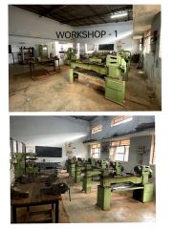
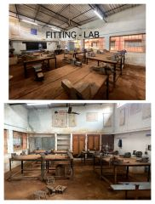
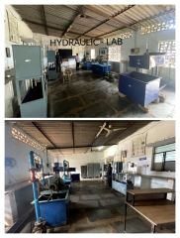
AVAILABILITY OF LABS/WORKSHOPS
Sl. No. | Name of the Laboratory | Name of the important Equipment (Costing more than Rs.30,000)
1 | BASIC W/S Practice-I | Bench vice, Drilling machine
2 | IT Skillls | PC 20 Nos
3 | BEEE | CRO
4 | CAED Lab | PC 20, Solid
5 | Basic Workshop-II | Forge, Power hammer
6 | MOM Lab | 1)Universal testing machine
7 | FPE Lab | 1)Pelton wheel 2) Francis Turbine 3) Notch apparatus 4) Venturimeter
8 | M/C shop | 1)Lathes 2)Shapers 3)Milling Machine 4) Slotting machine 5) Drilling machine 6) Grinding machine

Slide 46
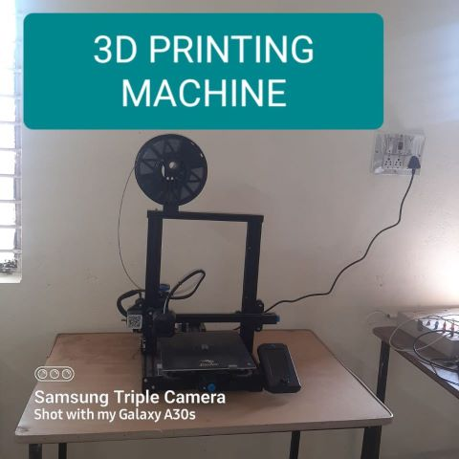
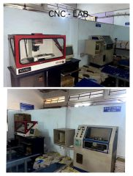
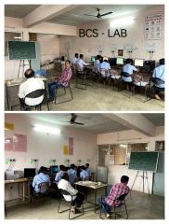
AVAILABILITY OF LABS/WORKSHOPS
Sl. No. | Name of the Laboratory | Name of the important Equipment (Coasting more than Rs.30,000)
1 | EIA Lab | PLC Kits,LCD Projector,
2 | PDD Lab | Shared
3 | OM Lab | Shared
4 | CNC | 1. CNC Trainer lathe 2. CNC Mill
5 | AMT Lab | Projector, PC, 3D Printer

Slide 47
CRITERIA – 7 CONTINUOUS IMPROVEMENT

Slide 48
PO & PSO TARGET SET & ACHIEVED
BATCH | TARGET/ ACHIEVED | PO1 | PO2 | PO3 | PO4 | PO5 | PO6 | PO7 | PSO1 | PSO2 | PSO3
2020-21 TO 2022-23 | TARGET | 2.89 | 2.58 | 2.8 | 2.76 | 2.166 | 2.333 | 2.5 | 3.00 | 3.00 | 3.00
 | ACHIEVED | 2.61 | 2.37 | 2.32 | 2.53 | 2.005 | 2.15 | 2.33 | 2.783 | 2.32 | 2.705
2018-19 TO 2020-21 | TARGET | 2.5 | 2.8 | 2.65 | 2.58 | 2.0 | 1.96 | 2.56 | 2.69 | 1.75 | 2.45
 | ACHIEVED | 2.09 | 2.36 | 2.33 | 2.18 | 1.74 | 1.89 | 2.22 | 2.36 | 1.56 | 2.12

Slide 49
SEMINARS CONDUCTED
Sl. No. | Gap | Action Taken | Date- Month- Year | Resource Person with Designation | Mode | No. of Students Present | Relevance to POs & PSOs
1 | PO2,PO7, PSO1 | Units & Dimensions | 5/8/23 | Mahesh Buddha Lecturer Science Dept | Chalk & Talk | 57 | PO1,PO5,PO7
2 | PO5,PO7 | Basic Mathematics & calculator operations | 26/8/23 | Panduranga and Harsha, KFIL Hosapete | PPT | 50 | PO5,PO7
3 | PO1,PO7 PSO2 | Road safety | 25/11/23 | Shaikshavali, Vishwas Motor Driving School,Hosapete | PPT | 52 | PO5,PO7
4 | PO6,PO7 | Career Opportunities | 18.01.2022 | G K Shivaprasad Manager, JSW | PPT | 65 | PO5,PO7
5 | PO1,PO2 | Basic mathematics and operating calculator | 22.08.2022 | Panduranga and Harsha KFIL Hosapete | PPT | 65 | PO5,PO7
6 | PO5,PO7 | Human values | 30.06.2021 | T Naziruddeen HOD, Mech | PPT | 62 | PO7
7 | PO6,PO7 | Entrepreneur ship Development Programme | 22.07.2021 | Somashekar Joint Director, DIC,Ballari | PPT | 65 | PO6,PO7
8 | PO2,PO7, PSO1 | Units & Dimensions | 08.11.2021 | Smt. Jotsna G Datar, Sl Gr Lect | Chalk & Talk | 57 | PO1,PO5, PO7
9 | PO6,PO7 | Career Opportunities | 18.01.2022 | G K Shivaprasad Manager, JSW | PPT | 65 | PO5,PO7
10 | PO5,PO7 | Industrial Safety | 31.01.2022 | Vijaykumar Engineer, JSW | PPT | 65 | PO5,PO7
11 | PO5,PO7 | Human values | 30.06.2021 | T Naziruddeen HOD, Mech | PPT | 62 | PO7
12 | PO5,PO7 | Interview techniques | 15.06.2021 | T Naziruddeen HOD, Mech | PPT | 65 | PO7
13 | PO6,PO7 | Entrepreneur ship Development Programme | 22.07.2021 | Somashekar Joint Director, DIC | PPT | 65 | PO6,PO7

Slide 50
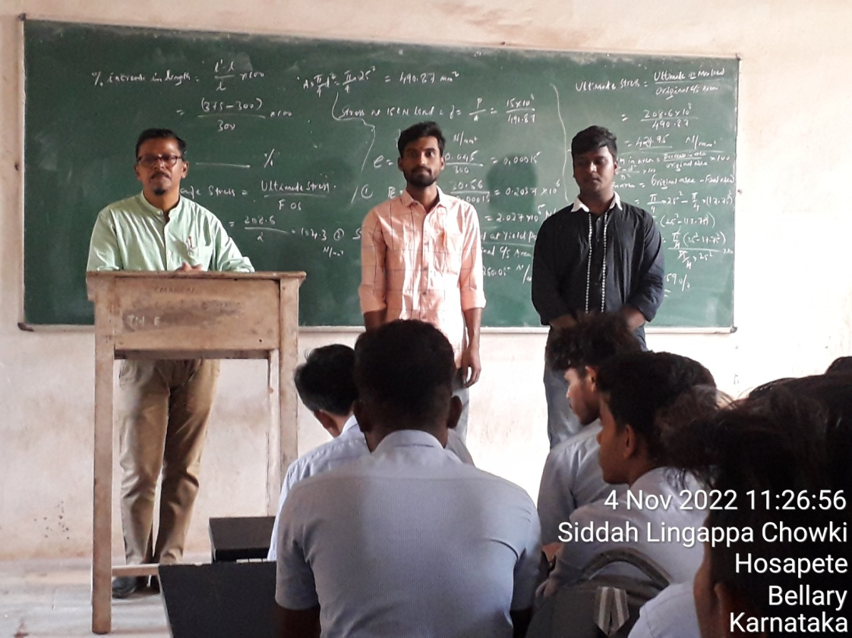
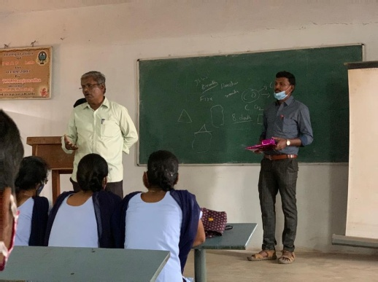
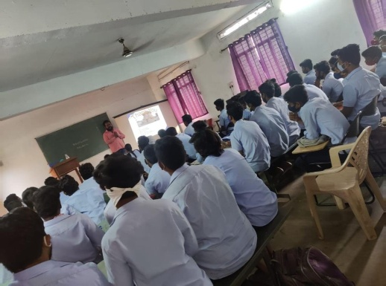
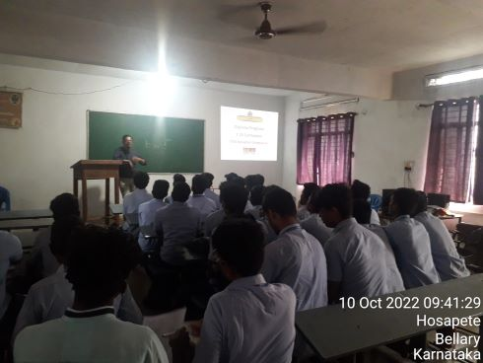
SEMINARS CONDUCTED
Seminar on Industrial Safety

Slide 51
IMPROVEMENT IN SUCCESS INDEX
Items | Latest Passed out Batch (2020-21) | Latest Passed out Batch minus 1 (2019-20) | Latest Passed out Batch minus 2 (2018-19)
Success Index | 0.369 | 0.294 | 0.157

Slide 52
IMPROVEMENT IN PLACEMENT INDEX
Items | Latest Passed out Batch (2020-21) | Latest Passed out Batch minus 1 (2019-20) | Latest Passed out Batch minus 2 (2018-19)
Placement Index | 0.475 | 0.767 | 0.8

Slide 53
STUDENT PROJECTS
4 projects done by students are used in program labs for conducting experiments.
Sl. No | Name of the Project | Name of the Lab | Academic Year
1 | Rectangular & V Notch Apparatus | Fluid Power Engg Lab | 2020
2 | Centrifugal Pump test rig | Fluid Power Engg Lab | 2020
3 | Conveyor Belt using PLC | Elements of Industrial Automation Lab | 2020
4 | Solar Tree | Department for supplying power during power cut. | 2021

Slide 54
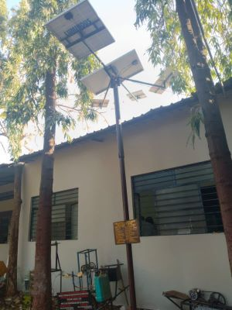
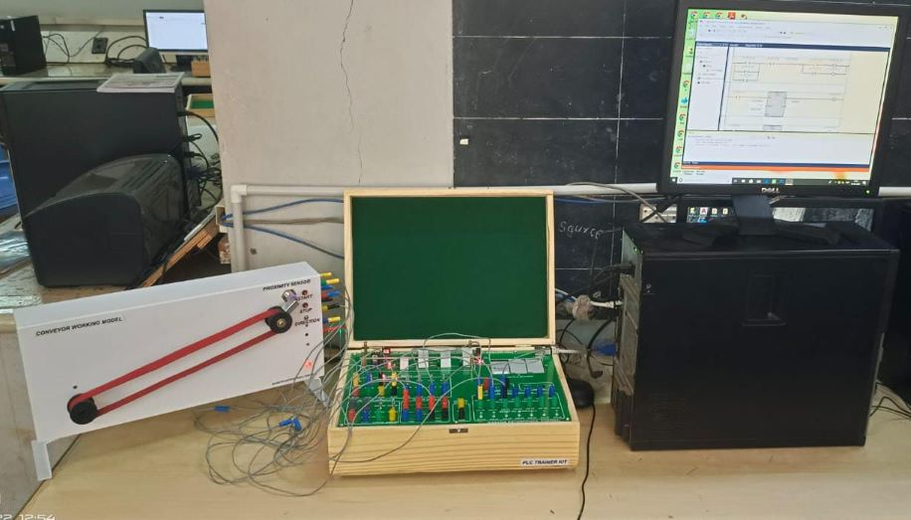
NEW FACILITY CREATED IN THE PROGRAM
Items | CAYm1 2022-23 | CAYm2 2021-22 | CAYm3 2020-2021
New Facility Created | 3D PRINTER | SOLAR TREE | CONVEYOR BELT USING PLC

Slide 55
PART B OBE PHILOSOPHY OF THE DEPT OBE- promotes better student- teacher interactions

Slide 56
What is OBE
Outcome Based Education (OBE) is a student-centric learning methodology in which course delivery, assessment are planned to achieve stated objectives & outcomes.

Slide 57
Why OBE

Slide 58
OUTCOME BASED EDUCATION
OBE Process Implementation
OBE COMPONENTS
Vision & Mission
OBC
(Curriculum)
OBTL
(Teaching Learning)
OBA (Assessment)
Program Educational Objectives (PEOs)
Program Specific Outcomes (PSOs)
Program Outcomes(Pos)
Course 1
CO1,CO2,CO3...
Course 2
CO1,CO2,CO3...
Course n
CO1,CO2,CO3...

Slide 59
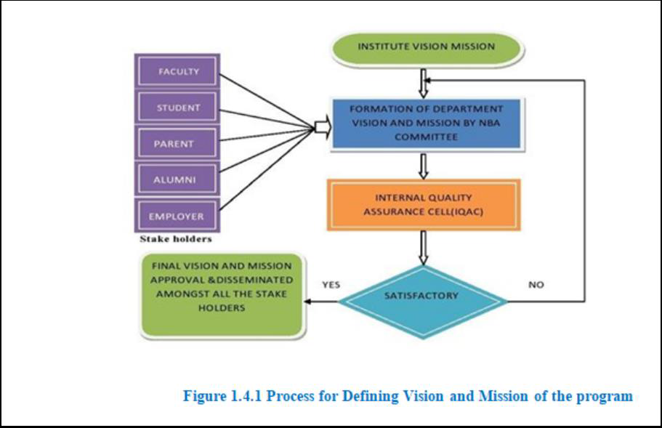
PROCESS FOR DEFINING VISION & MISSION

Slide 60
PROCESS FOR DEFINING PEO’s

Slide 61
PROCESS FOR DEFINING PSO’s

Slide 62
Pedagogical Initiatives in Teaching Learning
Calendar of events
Course allotment order
Class Time Table & Individual Time Table
No. of Lecture hours available and planning for extra classes required if any, based on the Time Table & Calendar of Events
Preparation of lesson plan
Self prepared notes - Chapter Wise/ Section Wise/ Topic Wise
Preparation of Question Bank Chapter Wise/Section Wise/Topic Wise
Preparation of PPTs
List of URLs, Video links & other
Preparatory Phase
Execution Phase (Teaching and Delivery Phase) Pedagogies
Lecture
White Board Teaching 2. Videos 3. Animations 4. Power Point Presentations 5. Models
Invited Talks  Workshops
Industrial Visits  Inplant Training
Exhibits
Academic & Course File
Internal Audit Reports
Feedback Analysis
Students:
Internal Assessments 2.Assignments 3.Activities
4. Identification of Slow & Fast Learners & action thereon. 5.Mini Projects 6. Rubrics
Faculty:
1. Internal Quality Audits 2. Students feedback on Teaching & Learning
Execution Phase Assessment
(Assessment)

Slide 63
PO/PSO’s ATTAINMENT

Slide 64
CO-PO/PSO MAPPING METHOD
 | Course Outcome | POs | CL | Class Sessions | Lab Sessions (Hrs)
CO1 | Understand and distinguish the behavior of simple load carrying members subjected to an axial, shear and thermal Loading. | PO1, PO2, PO3 PSO1 | U | 12
CO2 | Interpret the Variation of moment of inertia for different Mechanical Engineering Sections | PO1, PO2, PO3 PSO1 | U | 10 | -
CO3 | Draw and Compare the shear force and bending moment diagram on beams under varying load conditions. | PO1,PO2,PO3 PSO1 | App | 12 | -
CO4 | Assess Bending and shear stresses in beams subjected to different loadings for different machine parts | PO5, PSO1 | Ap | 8 | -
CO5 | Differentiate in strain energy stored in a body when the load is suddenly applied and gradually applied | PO5, PSO1 | Ap | 4 | -
CO6 | Design simple power transmission shaft for professional engineering solutions in societal and environmental contexts | PO5, PO6, PSO1 | Ap | 6 | -
Total Hours of instruction |  |  |  | 52 | -
34 of 52 (65%) sessions are devoted to PO1 | Mapping strength is 3
34 of 52 (65%) sessions are devoted to PO2 | Mapping strength is 3
34 of 52 (65%) sessions are devoted to PO3 | Mapping strength is 3
18 of 52 (35%) sessions are devoted to PO5 | Mapping strength is 2
6 of 52 (11.53%) sessions are devoted to PO6 | Mapping strength is 1
52 of 52 (100%) Sessions are devoted to PSO1 | Mapping strength is 3

Slide 65
RUBRICS FOR THEORY SUBJECTS
RUBRICS FOR ACTIVITY
Dimension | Beginning | Developing | Satisfactory | Good | Exemplary | Student Score
 | 4 | 8 | 12 | 16 | 20
Information search & Collection |  |  |  |  |  | 16
Involvement in activity |  |  |  |  |  | 12
Timely submission |  |  |  |  |  | 16
Presentation |  |  |  |  |  | 8
Average / Total Marks: (16+12+16+8)/4 |  |  |  |  |  | 13 Marks

Slide 66
RUBRICS FOR PRACTICAL SUBJECTS
RUBRICS FOR ACTIVITY
Dimension | Beginning | Developing | Satisfactory | Good | Exemplary | Student Score
 | 2 | 4 | 6 | 8 | 10
Information search & Collection |  |  |  |  |  | 8
Involvement in activity |  |  |  |  |  | 6
Timely submission |  |  |  |  |  | 8
Presentation |  |  |  |  |  | 8
Average / Total Marks: (8+6+8+8)/4 |  |  |  |  |  | 7.5 = 8 marks

Slide 67
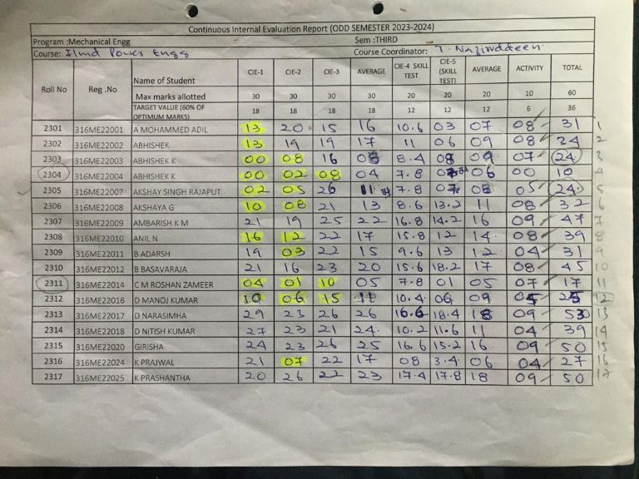
CIE REPORT FORMAT

Slide 68
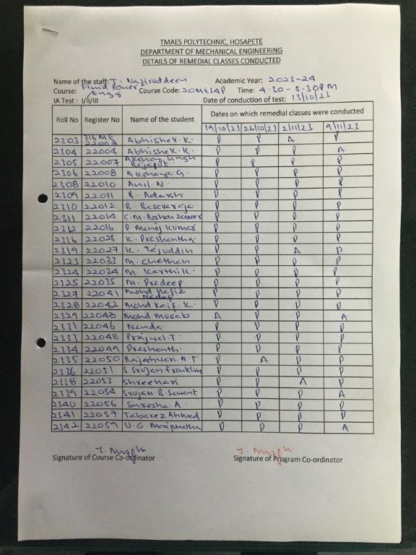
REMEDIAL CLASSES FORMAT

Slide 69
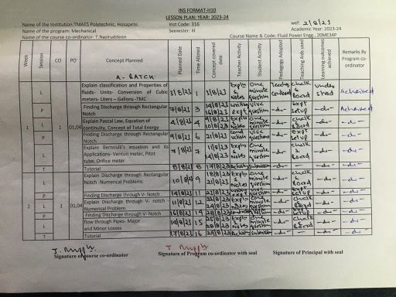
COURSE PLAN FORMAT

Slide 70
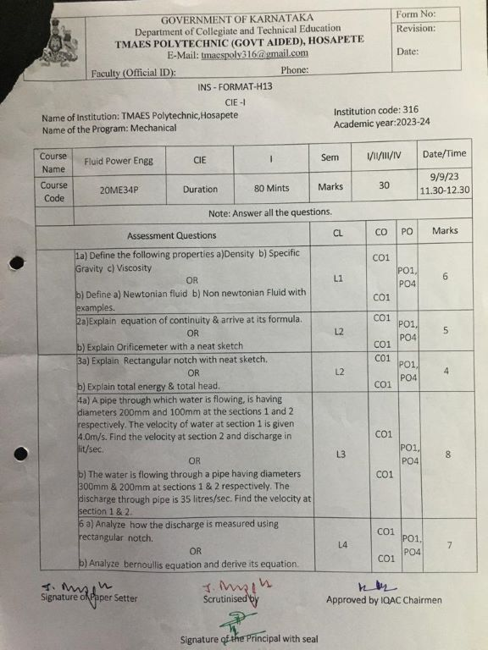
CIE QUESTION PAPER FORMAT

Slide 71
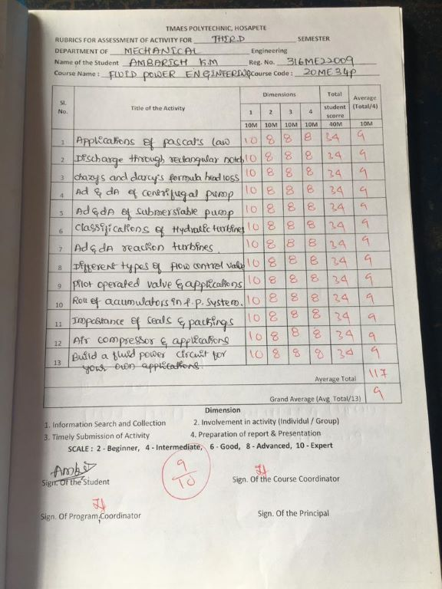
SAMPLE RUBRICS FOR PRACTICALS

Slide 72
DEPT OF MECHANICAL ENGG.
BRAND VALUE:
More students opt to join the program.
Reasons:
1. Dedicated teaching faculty & technical supporting staff.
2. Good results every year.
3. More placements.
CHALLENGES:
Knowledge of maths & science in fresher’s admitted.
English communication skills of fresher's.
Career guidance programs.
Effective participation of students in teaching learning processes.
More industries to be invited for placements.

Slide 74
THANK YOU

